Slide 1
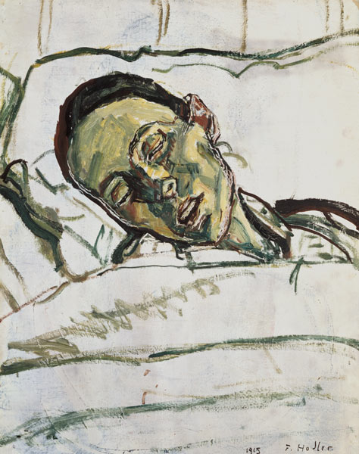
Identifying those at risk of dying
Dr Fiona Lisney
Consultant in Palliative Medicine
Frimley Health NHS Foundation Trust
01753 634879
Fiona.lisney@nhs.net

Slide 2
Agenda:
Why?
Do we have a problem?
‘Hot tips’ for identification and prognostication

Slide 3
Clinical Outcomes
Survival
Return to an acceptable functional state (PS)
Minimise suffering
Cost effective/equitable use of resources

Slide 4
Identification of those ‘at risk of dying’ Why?
Decision making ‘in context’
‘More likely to die than live’
Prognosis and ‘Core philosophy’ influences:
Goals of care
Patient choice
Equitable use of health care resources

Slide 5
What is important to dying patients?
Symptom management
Control and autonomy
place of death
QOL > survival
Avoid ‘burden’ to those we love
religious/spiritual needs met
‘A life lived’
Most desirable age to die is 81-90
Only 6% of people >65yrs want to live to >100yrs

Slide 6
EOL clinical outcomes
Survival
Return to an acceptable functional state (PS)
Minimise suffering
Cost effective/equitable use of resources
Minimise suffering
Managed death in the place of choice
Holistic care – including cultural and religious requirements
Support for bereaved family/carers
Care of the body after death
Cost effective/equitable use of resources
Survival?
Notes:
Prognostication
Available treatment options
Whether life prolongation is a) what the patient wants and b) in their best interests

Slide 7
Early identification & integration of Specialist Palliative Care
Improves QOL and survival with no cost difference
(Higginson et al, Lancet RespMed Dec 2014;2(12):979-987/Temel et al, NEJM 2010;363:733-42)
Doubles the odds of dying at home
(Gomes et al, Cochrane database,2013.June 6;6:CDoo7760)
Halves AE attendances for those in the last month of life
(Hensonet al, J Clin Onc 2015Feb 1;33(4):370-376)

Slide 8
Early identification …. ‘rectangles to triangles’
Modern concept of palliative care
Bereavement care
Curative treatment
End of life
care
Curative treatment

Slide 9
Do we have a problem?

Slide 10
2 areas of concern:
Under treatment & harm reflected in premature, avoidable deaths
Poor identification of inevitable dying and consequent over treatment and harm

Slide 11
Hospital – the reality
Those in the last year have 3.5 Hospital admissions
Lyons and Verne 2011
1 in 3 DGH inpatients will die within a year
Clark et al, Palliative Medicine 2014/National audit office 2008
Increases to 1 in 2 for the socio economically deprived extreme elderly (>85 yrs) admitted to medical wards via A&E
(Clark et al, Palliative Medicine 2014)
1 in 10 adult inpatients in a DGH will die during the admission
(Clark et al, Palliative Medicine 2014)
54% in hospital deaths follow an admission of ≥8 days.
86% follow an emergency admission, the LOS is 27/7

Slide 12
Hospital – a ‘system designed for others’
Survival focus
Large volumes
Lack of individualised care
Clinical environment
Increasing Complexity
Older
10-20% of all ICU admissions >75years
Sicker
50% have > 3 diseases
Modern families
Cultural and religious diversity
Geographically separated

Slide 13
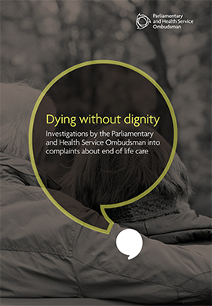
Dying without dignity 2015
Not recognizing that people are dying or responding to their needs
Poor symptom control
Poor communication
Inadequate out-of-hours services
Poor care planning
Delays in diagnosis and referrals for treatment

Slide 14
Confidential enquiry into premature deaths (COIPD) 2013 in Learning disability
Commissioned to provide evidence about contributory factors to avoidable and premature deaths in this population
247 deaths (4years) in SW England.
Median survival mid 60’s
-13 yrs for men
-20 yrs for women
42% premature
29% delayed diagnosis
30% treatment problems
Lack of care coordination
Poor identification of dying
Poor use of MCA

Slide 15
Place of death Personal/demographic features
Hospital
Older
Ethnic minority groups
Discordance between patient and family
Home
Married
Further education
Higher household income
Care home
Living alone

Slide 16
Place of death Disease related factors
Hospital
Higher levels of co-morbidity
Uncertain prognostication
Home
Longer disease trajectory
Care Home
Older
Dementia/cognitive impairment

Slide 17
Growing concern re over treatment & harm
ICE – CUB 2 study
3036 >75years
Lowered threshold for ICU admission
Doubled ICU admission
No Benefit, and potential harm
Higher (or equal) 6/12 mortality
JAMA.2017;318(15):1450-1459
PLoSOne.2012;7(4):e34387

Slide 18
The importance of identification Last months of life in LD in UK Stuart Todd - UoSW
32 UK LD providers – supporting 13,200 people with LD
Supported living services – 8,596
Residential care homes - 3,829
LD nursing homes – 361
216 deaths in 18 months
Modified Voices survey (staff)

Slide 19
Death in usual place of residence (UPR)
Expectedness of death
LD population – 36%
More expected with defined diagnosis (Downs - 58% vs 30%)
No difference between care homes/sheltered living
Expected dying and place of death
72% UPR vs 38% other

Slide 20
Is place of death a predictor of poor experience?
Hospitals biggest EOL provider
47% of all deaths (20 – 40 adult deaths/week)
LD 64%
National survey of bereaved people (voices) 2015
Those dying in Hospital have the worst experience
Compared with care homes, hospice care or care at home

Slide 21
Death in UPR has become a quality measure.
It is strongly associated with the ‘expectedness’ of death

Slide 22
So we need to prognosticate and identify to:
Avoid over treatment and harm
Survival
Minimise suffering
Enable death in the usual place of residence
Improve patient experience
cost effective use of health care resources
To support bereaved relatives/carers
Communicate well
To support appropriate social/religious/cultural requests

Slide 23
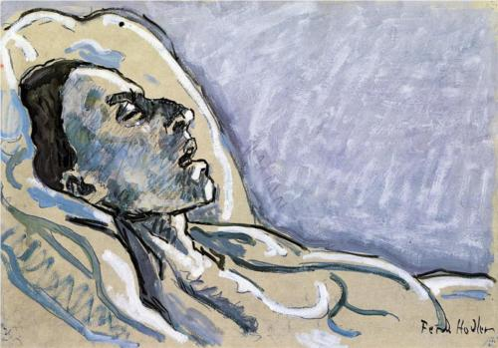
Models to identify and prognosticate

Slide 24
It’s not easy …
Fear of death and systematic denial/bias
The four stories we tell ourselves about death:
Elixir of life/fountain of youth
Stem cells/genetic engineering/immunotherapy
Resurrection
Religion/reincarnation
Soul/spirit
Religion/spirituality
"I am more than my body”
Legacy
https://www.ted.com/talks/stephen_cave_the_4_stories_we_tell_ourselves_about_death#t-918296

Slide 25
Religion and Preferences for Life-Prolonging Care
‘Religiousness’ is associated with wanting all measures to extend life
J Clin Onc 2007;25:555-60.
JAMA 2009;301:1140-7

Slide 26
Interventions for this:
Spiritual support from the clinical team assoc with higher QOL near death
J Clin Onc 2010;28:445-52
J Pall Med 2006;9:646-57
J Clin Onc 2007;25:555-60
Cost effective
Cancer 2011;117:5383-91
But spiritual support outside the clinical team not the same
JAMA Intern Med. 2013 Jun 24;173(12):1109-17.

Slide 27
This is fascinating …
But spiritual care is poorly incorporated into clinical practice: National End of Life Care Audit – Dying in Hospital 2016
Evidence of discussion during the last episode of care regarding the patient’s spiritual/cultural/religious/practical needs with 15% of patients who were capable of participating.
In a further 27% there had been discussion with a nominated person important to the patient.
Documented in 89% of cases, the identified spiritual/cultural/religious/practical needs had been met.

Slide 28
It’s not easy for clinicians …
Doctors overestimate survival
Particularly if:
Younger patient
Female physician
Less confident about prognosis
Most experienced physicians
Lamont et al, Annals of Internal Medicine 2001; 134: 1096-1105.
Notes:
28

Slide 29
Prognostication
Nurses
No worse than doctors
MDT
Better than doctors or nurses alone
Patients
61.4% want to know, but nearly all are over optimistic
Gwilliam B et al Ann Oncol.2013 Feb;24(2):282-8

Slide 30
Diagnosis
Living
Dying

Slide 31
Dying is a long term condition
A summary label
OR
An abnormal health state
Disability
Long-term care
Mortality

Slide 32
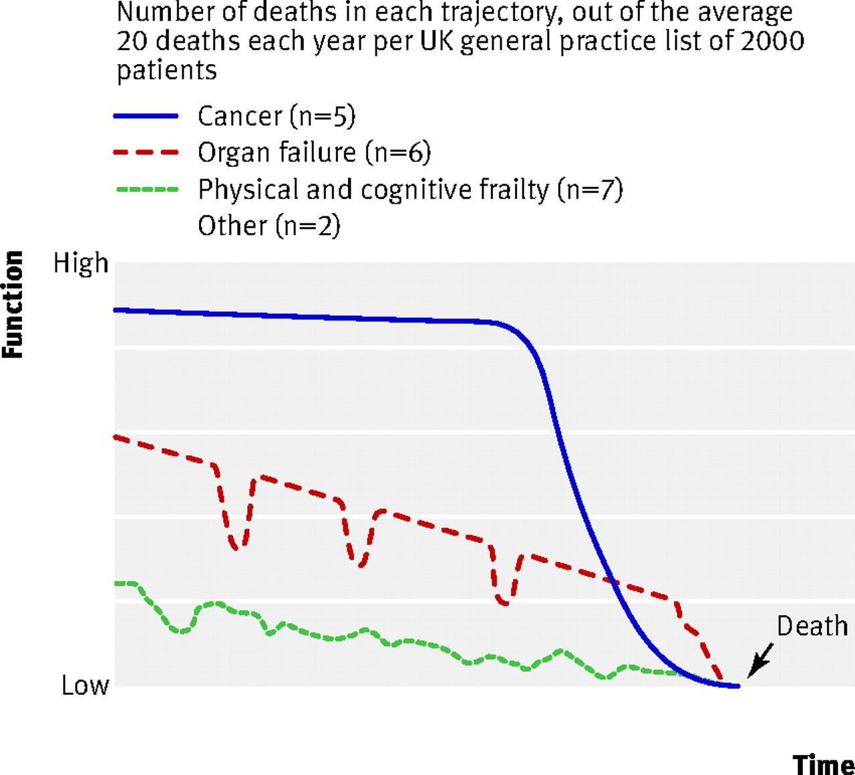
Increasingly complex prognostication
>80% of deaths are from LTCs
Within one condition different trajectories are encountered.
50% of older people have 3 or more LTC
Need to think of better ways to integrate palliative care outside prognosis
Bausewein et al Pall Med 2010; 24: 777

Slide 33
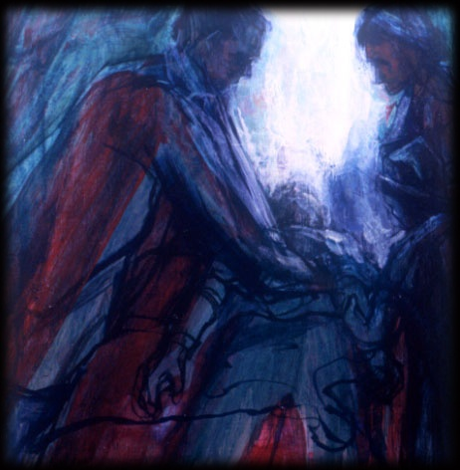
Living
Might Die
Dying
All active treatment
Ceilings of
active treatment
Comfort
Measures only
(slide courtesy of Mark Roland)
Notes:
33
Ask them what constitutes a good death……….

Slide 34
Prognostication - 3 step approach
How sick is this person?
Gut instinct - surprise question
Why do I think that?
Evidence your guts
Clinical prognostic indicators
General
Disease specific
What is the right thing to do?

Slide 36
Step 2 - General prognostic indicators
Unplanned Hospital admissions
Weight loss
New symptoms
Multiple co morbidities (eFI)
Biological markers
Deteriorating performance status

Slide 37
ECOG | Performance status
0 | Fully active, no restriction
1 | Ambulatory and able to do light/sedentary work.
2 | Ambulatory, capable of selfcare, unable to workcare. Out of bed >50% of waking hours
3 | Capable of limited self care, confined to bed/chair >50% of working hours
4 | Completely disabled. Bed/chair bound. No self care.
5 | Dead

Slide 38
Biological markers
Leukocytosis
Lymphocytopenia
Anaemia
C-reactive protein
Hypoalbuminaemia
Hypoprealbuminaemia
Proteinuria
Serum calcium
Serum sodium
Lactate dehydrogenase

Slide 39
Specific end of life indicators - dementia
Non ambulant
Double incontinence
No verbal communication
Unable to dress
Barthel<3
Weight loss (>10% in preceding 6 months)
Albumin<25%
Reduced oral intake
Pressure sores
Recurrent infection esp asp pneumonia

Slide 40
COPD
Severe disease (FEV1<30% predicted)
>2 admissions in 12 months
Fulfils longterm O2 criteria
MRC grade 5 – housebound
Low BMI (<20)
Established respiratory failure or previous ventilation for respiratory failure

Slide 41
Step 3 - What is the right thing to do?
Ethical and legal frameworks for decision making
Communication skills

Slide 42
Summary
Early identification and integration of SPC improves outcomes.
Survival
Death in the usual place of residence
Patient and family/carer experience
Bereavement outcome
Use of health care resources
It’s not easy
Human beings denial of death
Multi morbidity and PS
Prognostic uncertainty will always remain
Listen to your guts
Hold on to Individualised care
Get help - refer early to SPC

Slide 43
Thank you
Fiona.lisney@nhs.net
01753 634879

