Slide 1
Syringe Pumps What do GPs need to know? 21st January2020
Fiona Dorrington
Macmillan specialist Palliative Care Pharmacist

Slide 2
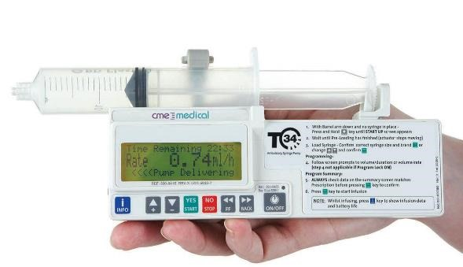
Syringe pumps
CME T34 pump

Slide 3
Syringe pumps
Deliver small volume subcutaneous infusion
Small volume risks with compatibilities of medicines
Line must only be used for infusion – give bolus PRN doses separately.

Slide 4
When to use
Patients unable to swallow
Unreliable absorption
Significant vomiting
NOT ONLY END OF LIFE

Slide 5
CME T34
Set to deliver contents of syringe
over 24 hours.
Device will calculate rate.
Can deliver 10ml – 37ml.
Nurses decide what volume.

Slide 6
Switching from Oral to Subcutaneous infusion
Opioids
Oral morphine or oxycodone to subcutaneous
2:1
Oxycodone m/r 40mg twice daily
= 80mg orally/24 hours
= 40mg /24 hours subcutaneously

Slide 7
Switching from Oral to Subcutaneous infusion
If symptomatic may require stat dose at the time the pump is set up.
May take up to four hours for effect of subcutaneous infusions to be seen.
Can overlap with M/R doses if taken.
In a community setting may need to be pragmatic about starting times to facilitate good routine.

Slide 8
Consider other symptoms
Nausea and Vomiting
May need a short term syringe pump to get on top of symptoms
Analgesic to ensure absorbed
Antiemetic tailored to likely cause of nausea
Reverse the reversible
If last days of life - levomepromazine – broad spectrum

Slide 9
Consider other symptoms
Distress
Benzodiazepines
Midazolam may be given subcutaneously

Slide 10
Prescribing
Use local paperwork
Can prescribe a range if wished (30 – 50% increments)
Needs regular review
PRN - need to specify doses and indications
All controlled drugs FP10 must specify:
Drug, strength, dose and dose interval
Morphine Sulphate 10mg/ml Injection – Give 5mg by s/c injection up to hourly for pain 10(ten) ampoules.
As required NOT legal without a dose interval

Slide 11
Sample Syringe pump sheet
Hard copy available – in East BERKSHIRE this is PINK.
There is facility to prescribe a range of doses if this is clinically appropriate.

Slide 12
Sample PRN sheet
Hard copy provided.
In Berkshire this is YELLOW.
Specify INDICATION – may require different doses for different indications.
Other areas will have their own paperwork – generally similar.

