Slide 1
Anticipatory Prescribing and Stopping Drugs at the End of Life 21st January 2020
Fiona Dorrington
Macmillan Principal Pharmacist Palliative Care

Slide 2
Medication Review in the last year of life
Consider carefully pharmacological and non-pharmacological factors
Altered metabolism of drugs
Prognosis / course of terminal illness & comorbidities
Measure of benefit (e.g. NNT)
Aims of intervention (e.g. primary, secondary, tertiary prevention)
Psychological effects of stopping drugs
Ref - Stevenson, Abernethy, Miller, Currow. BMJ 2004;329:909
Notes:
Perception of drs giving up – assure pts that not giving up means carefully reviewing the benefits and harms of all meds in a changing body

Slide 3
Case example
78 yr old male
COPD,
type 2 DM
Depression
HT
Osteoporosis.
Recent weight loss +++
Mesothelioma

Slide 4
Case example
Metformin 500mg bd
Salbutamol 2 puffs prn
Tiotropium [Spiriva] 2 puffs daily
Alendronate 70mg weekly
Furosemide 20mg od
Warfarin variable dose
Citalopram 20mg od
Simvastatin 40mg on
Amlodipine 5mg od
Omeprazole 20mg od
Dizziness and falls
BM’S 5-9
Chest pain and cough
Nausea and bloating
Notes:
Profound weight loss
No active treatment
Self caring but most of the day in a chair
Going to need to add more drugs!

Slide 5
Medication Review
Metformin 500mg bd X
Salbutamol 2 puffs prn
Tiotropium [Spiriva] 2 puffs daily
Alendronate 70mg weekly X
Furosemide 20mg od
Warfarin variable dose
Citalopram 20mg od
Simvastatin 40mg on X
Amlodipine 5mg od
Omeprazole 20mg od

Slide 6
Evidence base? Managing comorbidities in oncology: A multisite randomized controlled trial of continuing versus discontinuing statins in the setting of life-limiting illness. Abernathy et al, J Clin Onc 2014 no difference in 60 day mortality median survival slightly longer in non-statin group improved QOL in non-statin group cost savings

Slide 7
Top 4 Hit List for Review
Lipid-lowering drugs
Anti-hypertensives
Diabetic medication
Osteoporosis drugs

Slide 8
Anticipatory prescribing
Safely managing symptoms in the community

Slide 9
Just in Case Drugs
Manage common end of life symptoms.
Ensure drugs and means to administer them available
Plan ahead to avoid problems.
Give confidence to attending clinicians
Gives seamless symptom management.
Buy some time to get syringe pump

Slide 10
Why Bother?
70 year old widowed Sikh lady with metastatic breast cancer
DNAR form in place
Wish – die at home with family present
Son came from Singapore
DNs noted on a Thursday that condition was deteriorating...
GP “Not yet” to injectables
Actively dying on weekend
Son spent Saturday ringing OOHs and in pharmacy collecting drugs
....she died while he was out

Slide 11
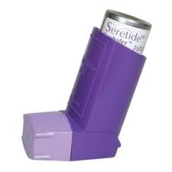
What is the cost?
?
Vs
Notes:
Seretide evohaler 125 £35 ; 250 £59

Slide 12
Just in case drugs Costs
Morphine 10mg/ml 1 x 10 ampoules
Midazolam 10mg/2ml 1 x 10 ampoules
Levomepromazine 25mg/ml 1 x 10 ampoules
Hyoscine Butylbromide 20mg/ml 1 x 10 ampoules
Drug Tariff cost: £39.02

Slide 13
Just in Case Drugs(oxycodone)
Oxycodone 10mg/1ml 10 ampoules
Midazolam 10mg/2ml 1 x 10 ampoules
Levomepromazine 25mg/ml 1 x 10 ampoules
Hyoscine Butylbromide 20mg/ml 1 x 10 ampoules
Drug Tariff cost: £45.18 (£37.18 if only 5 ampoules of oxycodone)

Slide 14
Anticipatory Prescribing Practical Tips
Make sure authorisation sheet is completed
Inform DN TEAM – will need to ensure syringes, needles, sharps box also in place.
Consider small supply of WFI as diluent
Regular review – paperwork and drugs in date and dose up to date
Patients store safely but make sure other family members and/or DN know where!
GSF, DNACPR triggers for consideration

Slide 15
Anticipatory prescribing Pain
Opioid dose is dependant on current opioid use
Opioid naive patient:
Morphine Sulphate 2.5mg – 5mg by s/c injection up to HOURLY
Mr Khan is already using oral morphine
Background dose can be converted to subcutaneous infusion
Breakthrough dose should also be prescribed
Example:
Morphine Sulphate m/r capsules 30mg twice daily
60mg orally/24 hours
30mg/24 hours by subcutaneous infusion
5mg s/c injection up to hourly if required for breakthrough pain

Slide 16
Anticipatory Prescribing Nausea
Use broad spectrum antiemetic
Levomepromazine 6.25mg 12 hourly as required for nausea
Has a long half life may be given as a single daily dose if appropriate in stable symptoms.
May also be used for significant agitation, where a frequency of 4 hourly may be necessary until symptoms are controlled

Slide 17
Anticipatory prescribing Distress
Benzodiazepines are useful here
Midazolam 10mg/2ml injection – need to choose high strength to ensure s/c doses can be given comfortably.
Midazolam 2.5mg – 5mg up to 2 hourly s/c for distress/anxiety
This is a controlled drug
Need to prescribe total quantity in WORDS and FIGURES for supply
10 (ten) ampoules

Slide 18
Anticipatory Prescribing Excess Secretions
Anticholinergic drugs can be useful – important to start early
Hyoscine Butylbromide 20mg/ml
20mg up to 4 hourly s/c for excess secretions
May also be used for colic symptoms

Slide 19
Care Homes
Skills vary around syringe pump confidence.
GPs reluctant to prescribe EOL drugs unless symptomatic
(Hockley et al 2004 ; Seymour et al 2011)
Concerns mainly around WASTAGE
49/92 (53%) residents documented as symptomatic at EOL (Audit by Morris & Hockley 2011)
Majority managed with Paracetamol supps (£36.50 for 10 x 500mg), midazolam and anticholinergic for secretions
Consider early prescribing/supply – once symptomatic may be too late.

Slide 20
Specific co-morbidities

Slide 21
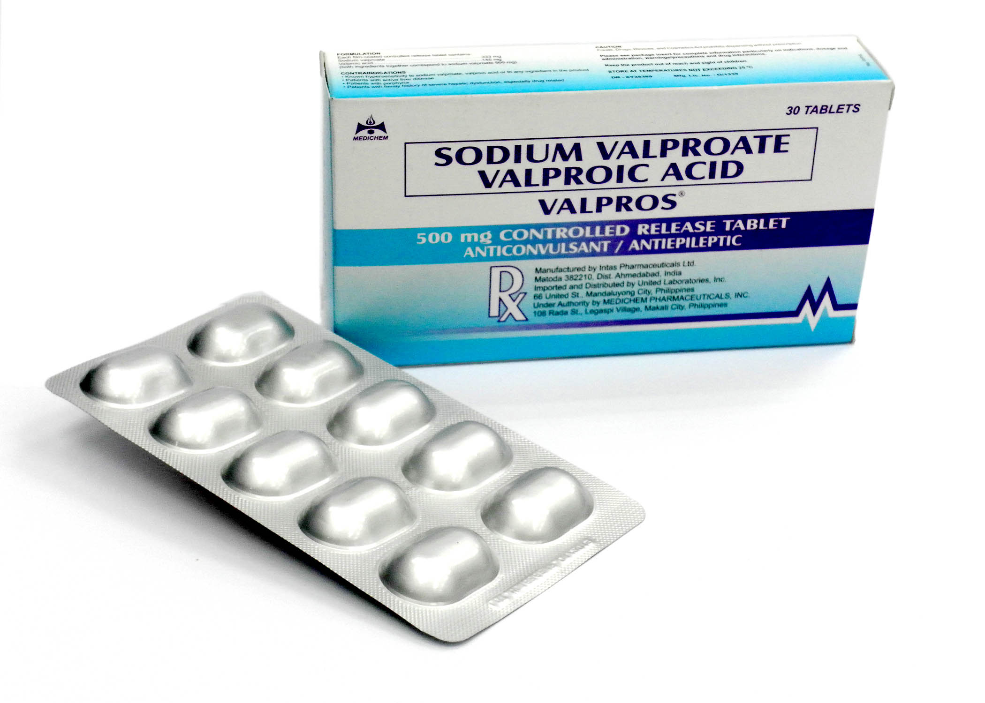
Epilepsy
50 yr old EOL with pancreas CA, can no longer swallow Na Valproate (lifelong for tonic-clonic seizures)
Consider Buccal Midazolam in case of seizure –
Midazolam 20-30mg over 24hrs sc in syringe driver
PRN Midazolam 5-10mg sc for seizures

Slide 22
Parkinson’s Disease
82 yr old EOL with oesophageal cancer with PD as comorbidity – swallow deteriorating
Think ahead and liaise with PD nurse specialist
Imminently dying (hrs /days) – treat rigidity with midazolam
Prognosis uncertain (?wks) – consider transdermal Rotigotine
2-4mg / 24hrs
Avoid haloperidol / metoclopramide / levomepromazine
Treat agitation with midazolam
Treat N&V with cyclizine or ondansetron
Notes:
Spasticity in MS patients

Slide 23
Resources
Berkshire Adult Symptom Control Guidelines – updated 2019
Berkshire End of life guidelines – covers last days of life and co-morbidities.
PCF 6
www.palliativedrugs.com – access to formulary requires subscription but free registration allows use of syringe driver compatibility data and bulletin board.
Palliative Care Team via SPA – 01753848925
Diabetes at the end of life – clinical recommendations – Diabetes UK

