Slide 1
Resuscitation and ceilings of treatment
Dr Sophie Price
Consultant in Palliative Medicine

Slide 2
Objectives
DNACPR decision making
DNACPR discussions
Establishing and discussing ceilings of treatment
Sharing these decisions with other professionals

Slide 3
Before we start….
Think about CPR attempts you have seen in your training so far ……
Think about DNACPR discussions you have observed – what went well, what went badly?

Slide 4
What is Cardiopulmonary Resuscitation?
The restoration of breathing and circulation following cardio pulmonary arrest
Basic: Chest compressions and rescue breaths.
Advanced: IV drug, defibrillation, airway protection & artificial respiration.

Slide 5
CPR OUTCOMES
2007 data:
15 – 20% survival to discharge IN hospital arrests
5 – 10% survival to discharge OUT of hospital arrests
2.3% survival to discharge Poor PS prior to arrest

Slide 6
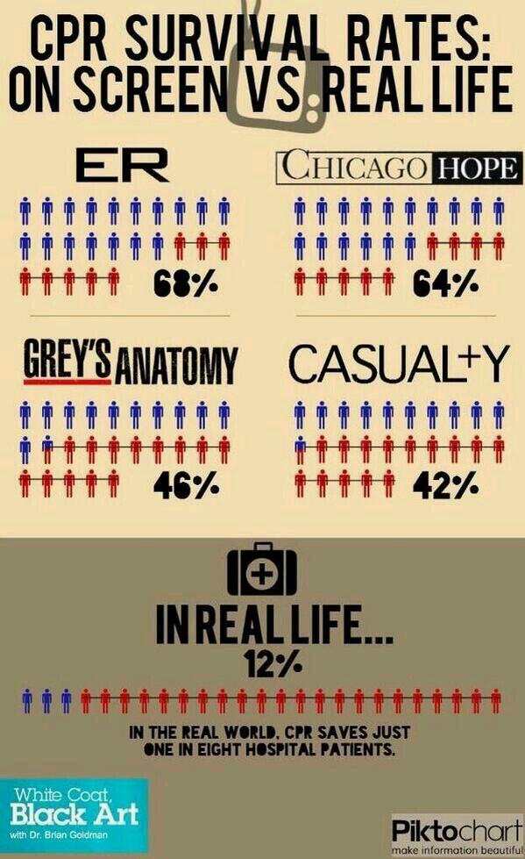

Slide 7
POTENTIAL HARMS OF CPR?
Broken ribs / sternum
Pneumothorax
Other organ damage (heart / liver)
Neurological disability
Family distress witnessing CPR (beware of over-paternalising)
Staff distress
Diversion of resources

Slide 8
CPR DISCUSSIONS – The good, the bad and the ugly?
Notes:
We would not ask a patient if they wanted bypass surgery if they were not a surgical candidate

Slide 9
CPR DISCUSSIONS – Who to involve?
Does the patient have capacity?
Ideally relatives and carers should be part of the discussion if the patient agrees
Patient lacks mental capacity
Most senior clinician responsible for decision
Is there a valid and applicable ADRT?
Is there a welfare attorney (LPA) or other legal surrogate?
Do they have family / friends / others involved for best interests meeting?
IMCA if no advocate
Notes:
LPA – property and affairs ; personal welfare
Other – Court appointed deputy or guardian

Slide 10
CPR DISCUSSIONS – Some common myths, misconceptions and pitfalls
Notes:
We would not ask a patient if they wanted bypass surgery if they were not a surgical candidate

Slide 11
Is a DNACPR form legally binding?

Slide 12
Does a DNACPR form mean I won’t get more treatment?

Slide 13
Can a patient or relative demand CPR?

Slide 14
Can I do a DNACPR for without informing the patient?

Slide 15
There should be a presumption in favour of discussion with the patient
Judgment in the Court of Appeal 2014:
“In my view, doctors should be wary of being too ready to exclude patients from the process on the grounds that their involvement is likely to distress them. Many patients may find it distressing to discuss the question whether CPR should be withheld from them in the event of a cardio-respiratory arrest. If however the clinician forms the view that the patient will not suffer harm if she is consulted, the fact that she may find the topic distressing is unlikely to make it inappropriate to involve her. I recognise that these are difficult issues which require clinicians to make sensitive decisions sometimes in very stressful circumstances”
Notes:
Janet Tracey 2014. Contravened human rights but not informing the patient / family of the decisions

Slide 16
Be clear whose decision it is
In “Best Interests” setting, NOT asking family to make the decision
Their views on what the patient would want will be taken into account
Cannot insist on a treatment, or on withholding / withdrawing a treatment

Slide 17
What if there is disagreement?
No legal right to a treatment that is clinically inappropriate
But offer second opinion
(not legally obliged if unanimous MDT decision)

Slide 18
As with all decisions...Document carefully
Attempts to involve patient
Rationale for decisions
Who was involved / consulted
Reasons why discussion would be harmful
Any conflict

Slide 19
CEILINGS OF TREATMENT
Antibiotics (IV, oral or none)
Ventilation (invasive, NIV)
Artificial hydration and nutrition (PEG / NG)
Hospitalisation vs Home / Hospice-based care
Ward vs ITU
Don’t forget ICD’s !

Slide 20
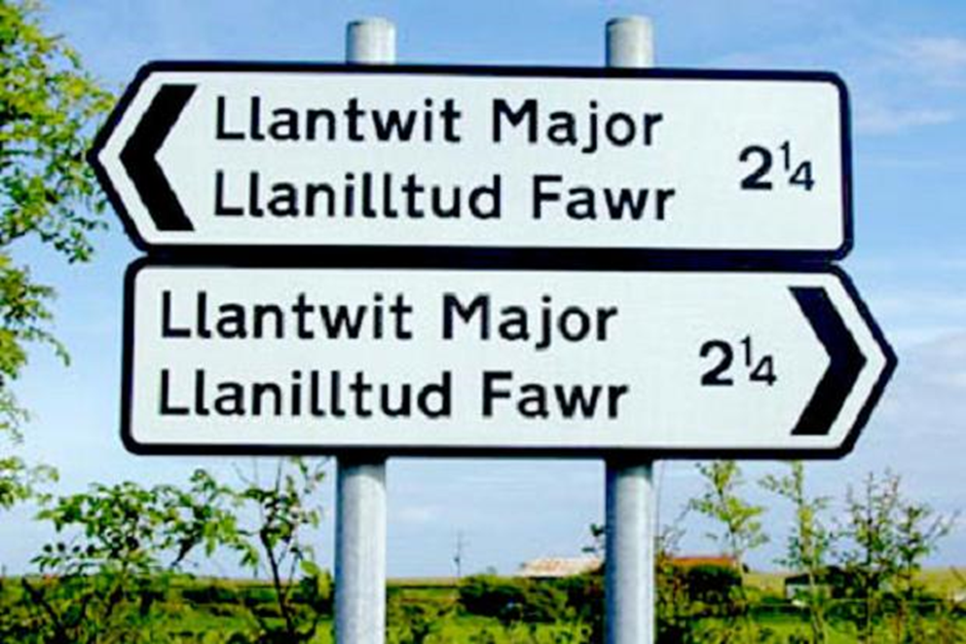
Discussing ACP and ceilings of care
Patient / relatives understanding of illness
Patients wishes
Options for treatment
Risks, benefits and likelihood of success

Slide 21
Just because we can, doesn’t mean we should

Slide 22
WHERE TO RECORD?
DNACPR form
ADRT (legally binding if valid & applicable)
Statement of wishes & preferences (not legally binding)
ADASTRA (EPaCCS)
Accessible across care boundaries
Including OOH primary care, ambulances, A&E
Notes:
EPACCS – elec pall care coordination systems

Slide 23
RESPECT
National form to record anticipatory decisions about CPR and other life-sustaining treatment and to guide decision-making in an emergency situation in which the person lacks capacity.

Slide 24
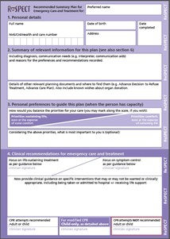

Slide 25
For more information:
BMA, RCN, Resuscitation Council (UK) 2014 Decisions relating to cardiopulmonary resuscitation. Guidance from the British Medical Association, the Resuscitation Council (UK) and the Royal College of Nursing
https://www.resus.org.uk/dnacpr/decisions-relating-to-cpr

Slide 26
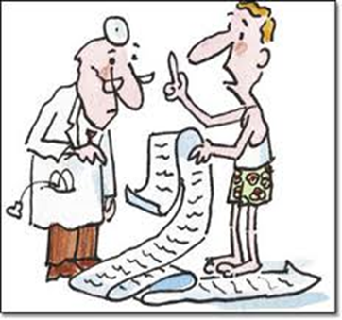
QUESTIONS ?

