Slide 1


Care after Death
21st January 2019
www.thameshospice.org.uk | 01753 842121 | | Charity No.1108298
Notes:
Please get involved - your contribution makes it more interesting for everyone
Every question is relevant
If you don’t know, you won’t know if you don’t ask!
Respect each other and the environment please
Please turn phones off or to silent mode

Slide 2

Aims of the session
Importance of timely verification
Definitions
Process
Care after death
Notifiable deaths

Slide 3
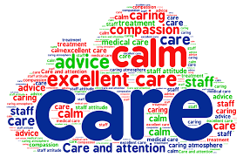
WHY IS TIMELY VERIFICATION IMPORTANT?
Part of the on-going process in EoLC
Improve experience of death & dying for the family
Reduction in delays
Date of death

Slide 4

Verification of Death
confirms that a person has died
DOESN’T have to be a doctor
Certification of Death
establishes the cause of death
MUST be a doctor

Slide 5
What is an ‘expected death’?
“… a death following on from a period of illness which has been identified as terminal, and where no active intervention to prolong life is ongoing.” (Ayris, 2002)

Slide 6

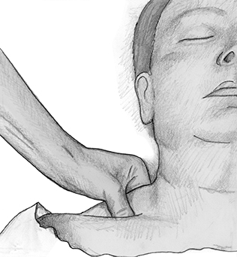
VERIFICATION PROCESS (AMRC, 2008)
Absence of central pulse for at least 1 minute
No heart sounds for at least 1 minute
Absence of breath sounds for at least 1 minute
CHECKING SHOULD TOTAL FIVE MINUTES
Cessation of cerebral function
    Pupils fixed & dilated
    No reaction to trapezius squeeze
Absence of carotid pulse for over one minute
Absence of heart
sounds on
auscultation for
5 minutes
Absence of carotid pulse for over one minute
Absence of heart
sounds on
auscultation for
5 minutes
Absence of carotid pulse for over one minute
Absence of heart
sounds on
auscultation f

Slide 7
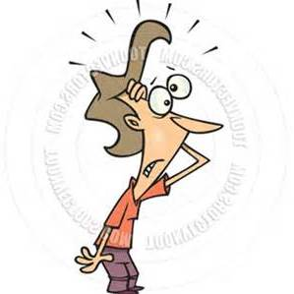
Spontaneous respiratory or cardiac activity…?
(AMRC, 2008)
Repeat the process for 5 minutes
Check fixed dilated pupils
Check corneal reflex
Check response to supra-orbital
pressure
No response to painful stimuli

Slide 8
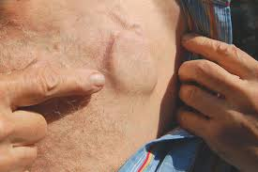
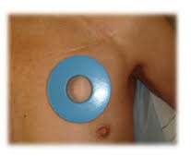
IMPLANTABLE DEVICES
ICD – defibrillators, CRTDs
Pacemaker
Radioactive implants
Intrathecal pumps and neurostimulators
Fixion nails

Slide 9
DEATHS REPORTED TO A CORONER
Recent change in guidance:
The deceased needs to be seen either 14 days prior or after death
There is now a legal duty to notify the coroner
The medical examiner system
  safeguards for the public - scrutiny of non-coronial deaths
  appropriate direction of deaths to the coroner
  better service for the bereaved - opportunity to raise concerns to a doctor not involved in the care of the deceased
  improve the quality of death certification
  improve the quality of mortality data

Slide 10
WHEN TO REPORT TO A CORONER
poisoning, or exposure to / contact with a toxic substance;
the use of a medicinal product, controlled drug or psychoactive substance;
Violence, trauma or injury;
self-harm or neglect, including self-neglect;
the person undergoing a treatment or procedure of a medical or similar nature
an injury or disease attributable to any employment held by the person during the person’s lifetime;
any other ‘unnatural’ death
the cause of death is unknown;
the person died while in custody
there is no attending medical practitioner
the attending medical practitioner is not available within a reasonable time to sign the certificate of cause of death;
the registered medical practitioner is unable to establish the identity of the deceased person

Slide 11

SUSPICIOUS DEATH?
E.g.
  Complaint about care
  Circumstances surrounding the death
Leave all I.V. cannulae & lines in situ
Clamp I.V. infusions & syringe drivers
Catheter & contents
Do not wash the body or do any mouth care

Slide 12
DEATHS REQUIRING POLICE ATTENDACNE
There situations are usually dealt with by paramedics. If you are called to one of these situations, consider police attendance:
‘Suspicious Deaths’ and where criminality may be a factor.
violent and unnatural deaths due to accident or trauma.
Fatal accidents of all types (e.g. Road Traffic Incidents, works accidents, factory accidents etc.).
Suicide.
Death due to suspected drug abuse.
deaths where alcohol is a contributory factor (e.g. where a person sustained a head injury whilst intoxicated).
Persons found dead after forced entry into premises. Even if the death appears to be from natural causes.
Person died in a public place.
Any death in hospital / care home where there may be criminal neglect or malpractice.
Deaths in private premises where the next of kin, family member, or other responsible adult will not take responsibility for the deceased
  likely to occur where the ambulance service have attended but the person on scene is not willing to remain and police presence is required to ensure arrangements are made for the body to be removed
Where body is found and the decomposition process has started.
Deaths where the person is not registered with a (local) GP.

Slide 13
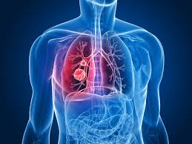
MESOTHELIOMA (TH POLICY)
Deaths from mesothelioma are considered ‘notifiable’ & coroner
needs to be informed
The doctor has overall responsibility for ensuring process is followed
A doctor or RN can verify the death
Dr. informs the local coroner via the online form found at
http://www.reading.gov.uk/coroners
The police are no longer required to attend or be informed of an
expected mesothelioma death
The person can be transferred to the family’s appointed FD
Family – coroner involvement & possible autopsy

Slide 14






CARE AFTER DEATH
https://www.gov.uk/after-a-death
‘Your guide to Bereavement’ (WAM Registration Service)
‘What needs to be done after a loved one dies’ Sue Ryder
Notes:
https://www.gov.uk/after-a-death
‘Practical information you need when someone has died’
‘Your guide to Bereavement’ (WAM Registration Service)
Sue Ryder ‘What needs to be done after a loved one dies’

Slide 15
RESOURCES
‘Care After Death. Guidance for staff responsible for care after death.’
hospiceUK (2015)
‘Guidance for staff responsible for care after death.’ Developed by the National End of Life Care Programme & National Nurse Consultant Group (Palliative Care) (2011)
‘Code of Conduct.’ NMC (2015)
‘A Code of Practice for the Diagnosis and Confirmation of Death (2008). Academy of Medical Royal Colleges.
British Medical Association (2015) Confirmation and certification of death. Available at: http://bma.org.uk/practical-support-at-work/gp-practices/service-provision/confirmation-and-certification-of-death
Local policies

