Slide 1
Infertility
PCOS
IVF
Miss Fatima Husain
MRCGP FRCOG DIPM
Consultant Obstetrician and Gynaecologist
Heatherwood and Wexham Park Hospitals
Frimley Health NHS Foundation Trust
Thames Valley Fertility
Spire Wexham

Slide 2
Infertility
The role of the GP
Improving the Patient Journey
Referral tests by GP’s audit 2014 .
Care pathway & Referral Proforma
How can we work better together?
Updated NICE Fertility guidance 2013
Local IVF funding criteria
Your questions

Slide 3
Introduction
1 in 7 heterosexual couples are infertile
NICE Guideline 2004.
Updated Feb 2013. CG 156

Slide 4


Slide 5



Slide 6
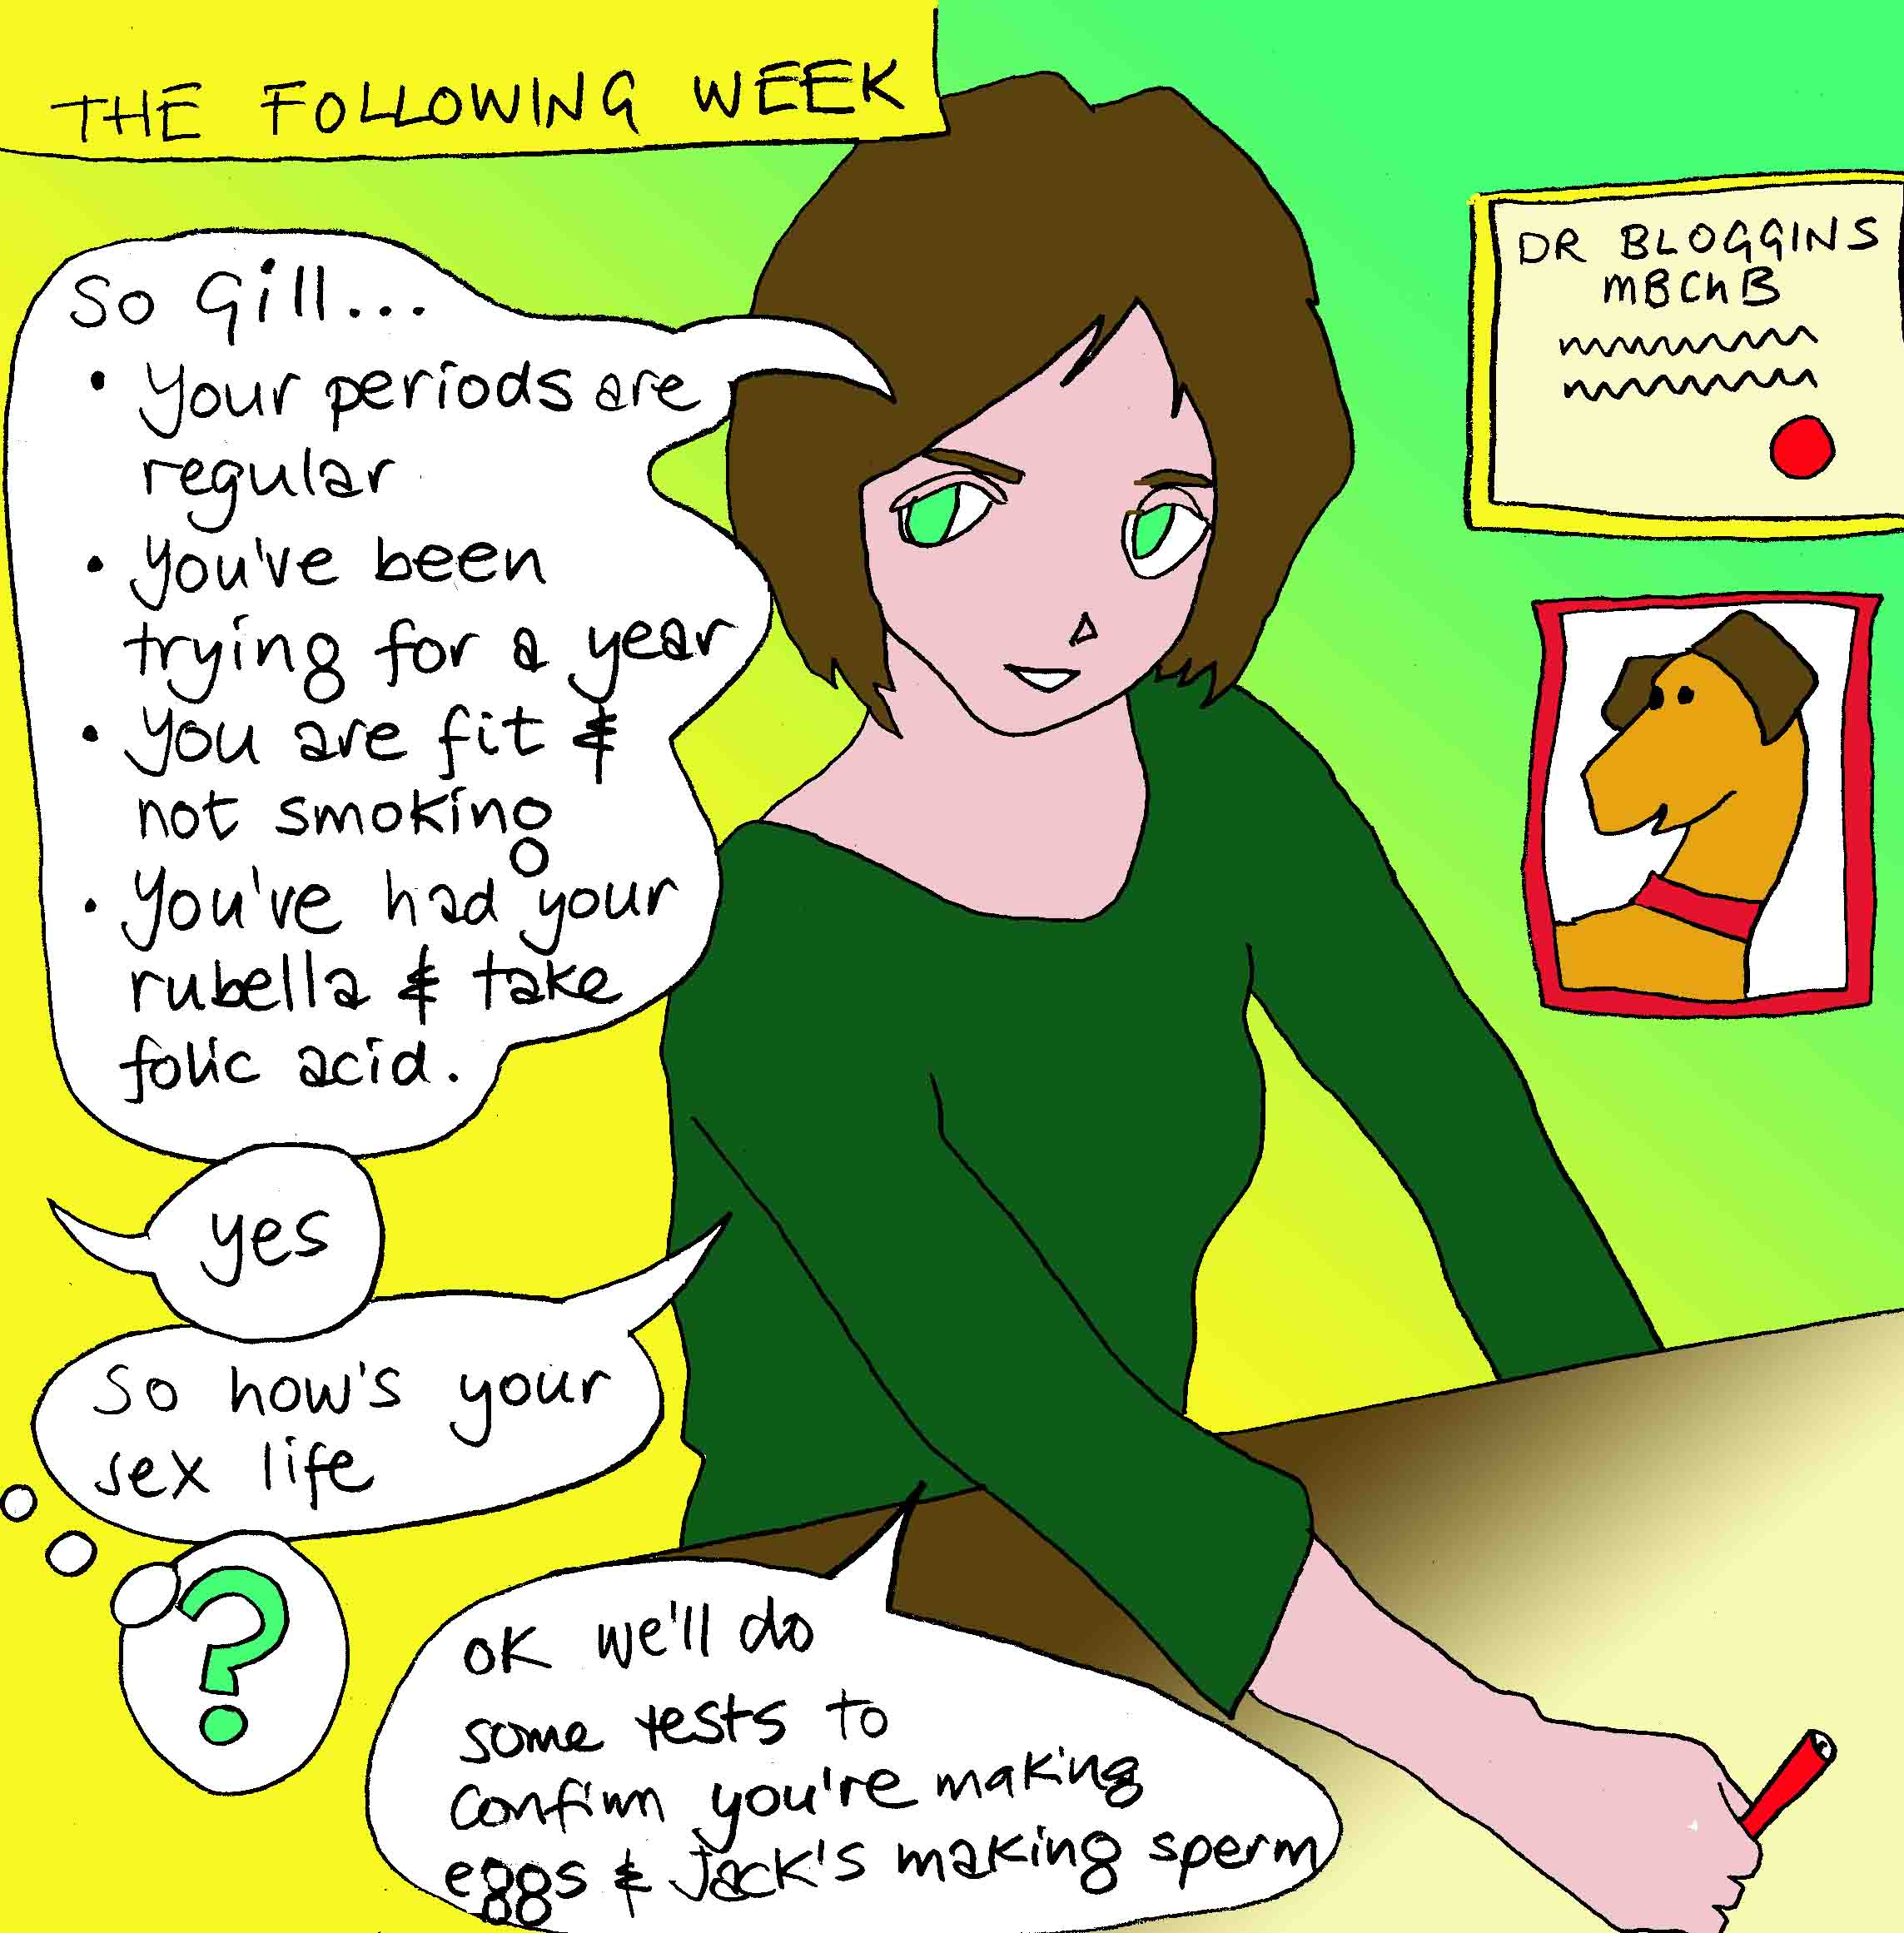
Sees the GP

Slide 7
The role of the GP I
Age
Previous Pregnancies
Regularity of Intercourse
Regularity of Menstrual Cycle
Previous History

Slide 8
The role of the GP II
Welfare of the Child
Folic Acid (dosage 5mg if DM, BMI >30)
Rubella Immunity test
Smoking
Alcohol (nil for women)
General Health, smears, Chlamydia test
Weight, BMI; this is very important!

Slide 9
The role of the GP III
Day 21 progesterone (midluteal..> 20 OK)
FSH, LH, Day 2-4 .ovarian reserve.
TSH ( TPO IF >2.5. , role for thyroxine)
Semen Analysis (same GP?)
TV Ultrasound of the pelvis
Chlamydia testing; urine PCR
Reassurance?
Can try Metformin in PCOS initially ( first 12 mths of trying…informed consent re license)

Slide 10
PCOS
Prevalence
4-12% of women, PCO on scan 20%
Ethnic variation: Black and white unselected USA: 4.6%,Greece 9%, South Asian in UK 52%
Pathophysiology:
Increased androgens
Slim PCOS: LH main drive
Obese PCOS: Hyperinsulinaemia main drive

Slide 11
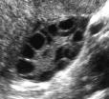
Irregular periods, cycle >6 wks :PCOS
The Rotterdam ESHRE/ASRM Consensus Group Revised 2003 Diagnostic Criteria for PCOS
2 out of 3 criteria required
Oligo- and / or anovulation
Hyperandrogenism—clinical and / or biochemical
Polycystic ovaries on TVS (vol>10cc)
Exclusion of other aetiologies

Slide 12
PCOS. BMI. Fertility
Aim for BMI less than 30 ( SE Asian <27 )
Weight loss: 5% of body weight may result in 30% reduction in visceral fat and restore reproductive function in >50% within 6 months.
Metformin may help , conflicting opinions, now NICE (2013) approved. Advantage: monofollicular ovulation, no need to monitor with scans.
Clomiphene: 5-10% risk multiple. needs scans
Letrozole: WHO approved but not licensed UK

Slide 13
Revised NICE guidelines 2013
Semen characteristics (WHO, 2010):
  Volume: 1.5ml or more
  Concentration: 15x10⁶/ml
  Total motility: 40%
  Morphology: 4% normal forms
  Vitality: 58%

Slide 14
Revised NICE guidelines 2013
A woman of reproductive age who has not conceived after 1 year of unprotected vaginal sexual intercourse, in the absence of any known cause of infertility, should be offered further clinical assessment and investigation along with her partner.
Offer earlier specialist referral where there is a known clinical cause of/predisposing factors to infertility or the woman aged 36 years or older
Case HISTORY
Notes:
Original in 2004
2 years of regular unprotected sex

Slide 15
Case 1
Mrs SS and Mr. KS. Primary subfertility 2 years
Indian, aged 30, married for 4 years
Since in UK weight inc, BMI now 38
Cycles every 8weeks-3 months for last 2 years.
Seen in OPD: advised weight loss, tests confirm PCOS, FAI was 8.8%, PRL 800,
Started on Metformin, review 6 months.
Clomiphene not so effective if BMI >30
Risk of obesity in pregnancy: GDM, PET,CS

Slide 16
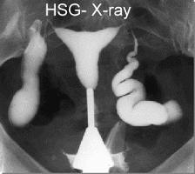
Secondary Care
Tubal Assessment - HSG

Slide 17
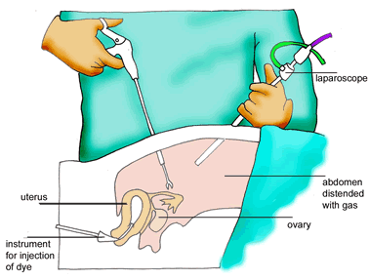
Secondary Care
Tubal Assessment - Laparoscopy

Slide 18
Secondary Care
Treatment, surgical endometriosis, mild tubal disease
Treatments for Anovulation
-Clomiphene
-Metformin, or both
-Lap Ovarian drilling
Tracking of Clomiphene cycles
Referral for tertiary care

Slide 19
Revised NICE guidelines 2013
For women with WHO group II anovulatory infertility, offer:
  Clomiphene or
  Metformin or GP could try this? (informed consent)
  Combination of both
For women taking Clomiphene:
  Offer ultrasound monitoring during at least the first cycle of treatment.( In progress )
  Do not continue treatment for longer than 6 months

Slide 20
Revised NICE guidelines 2013
For people with unexplained infertility, mild endometriosis, mild male factor infertility:
• Do not routinely offer intrauterine insemination
• Advise them to try to conceive for a total of 2 years before IVF will be considered.
YES, APPLIES LOCALLY, USED TO BE 3 YEARS

Slide 21
Revised NICE guidelines 2013
Do not offer oral ovarian stimulation agents e.g Clomiphene in unexplained infertility
Offer subfertile women aged <40y 3 full cycles IVF, and women aged 40-42y 1 full cycle IVF after 2 years of regular intercourse or 12 cycles of artificial insemination.
Prompt referral for consideration of IVF, in case of no or minimal chance of pregnancy through expectant management.

Slide 22
Revised NICE guidelines 2013
Access to IVF by age:
  There is no lower age limit.
  3 full cycles for women aged 23-39 years.
  NOT LOCALLY.
  Must START their treatment BY AGE 35 . Ie need referral at least 12 months before turn 35. to allow investigations to be completed.

Slide 23
Revised NICE guidelines 2013
  1 full cycle for women 40-42 years if:
    They have never previously had IVF
    There is no evidence of low ovarian reserve
    There has been a discussion of additional implications of IVF and pregnancy at this age
  It should not be offered for older than 43 years
  NONE OF THE ABOVE APPLIES LOCALLY

Slide 24
Tertiary Care
IUI
IVF
ICSI
Ovum Donation

Slide 25
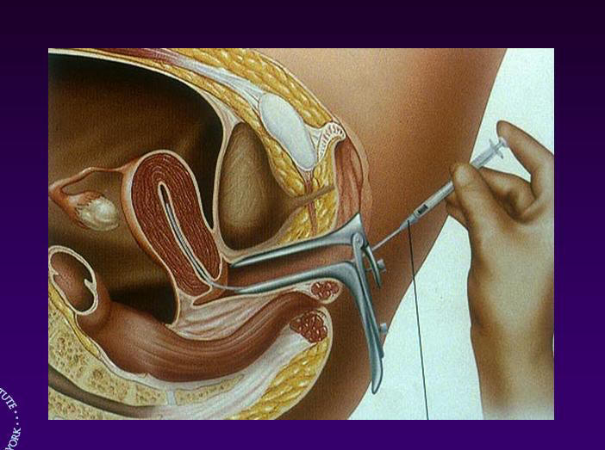
Tertiary Care - IUI

Slide 26
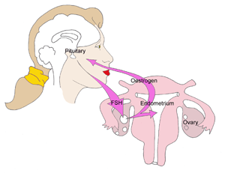
Tertiary Care – IVF and ICSI

Slide 27
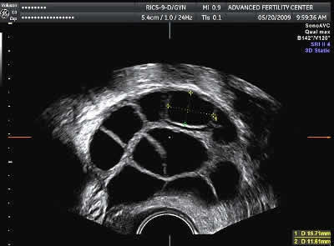
Tertiary Care – IVF and ICSI

Slide 28
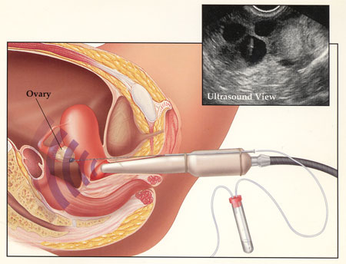
Tertiary Care – IVF and ICSI

Slide 29
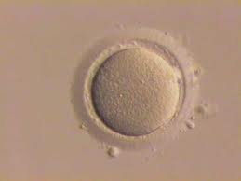
Tertiary Care – IVF and ICSI

Slide 30
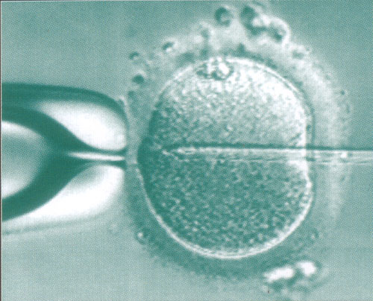
Tertiary Care – IVF and ICSI

Slide 31
Local Criteria for NHS Funded IVF
Female Age …no lower limit, up to 34.5 years
Unless absolute cause, 2 years of trying
No children either partner
Non smokers (both) for 6 months before
BMI less than 30
Not more than 2 self funded IVF cycles
NICE primary/secondary care pathway Ix

Slide 32
Pre-IVF referral essentials
Needs FSH <12 to meet criteria for NHS
GP: All standard tests within last 6-12 months
In addition for both partners, Hospital will do:
Hep B surface antigen, core antibody
Hep C
HIV 1 & 2.
Best just before referral as needs within 3 mths

Slide 33
Thankyou!
Advice, ring me 07855352941
NHS 01753 633705, Lauren

