Slide 1
Cancer: Early Diagnosis & Screening
June 27th 2017
Notes:
Introduce who we are
Explain that they have been provided with packs with various resources, and the slides will be shared with them afterwards – lots of useful weblinks on the slides
Ask if they could please sign the sheet that’s going round – so we know which practices are represented and so we have email addresses so we can share any useful resources in the future

Slide 2
What we will cover today:
Background and context to early diagnosis
PHE Fingertips practice profiles
https://fingertips.phe.org.uk/profile/cancerservices
NICE Guidance NG12 and new developments in cancer
Safety netting – a review of best practice
Cancer screening programmes and what practices can do to increase bowel screening uptake.
GP resources and support tools from CRUK and RCGP including audit tools.
Notes:
Briefly explain what we’ll be covering
Each session will be around 20 mins and will be a mixture of slides and interactive
Feel free to ask questions at any time as we go along
Background and context to Early diagnosis – CRUK stats on survival rates and routes to diagnosis and the important role that primary care has to play (20 mins)
A review of the finger tips PHE Cancer practice profiles – if we have wifi they can look at the practice profiles for their practices – facilitated discussion about the different indicators https://fingertips.phe.org.uk/profile/cancerservices (20 - 25 mins)
NICE Guidance 2015 and developments in cancer diagnosis
Safety netting – discussion of the NICE guidance, best practice and a review of their current practices to ensure patients don’t slip through the net – 1hr – using CRUK case scenarios, reflective practice work book. – interactive and discussion
Break
Screening – overview of the three programmes, discussion of initiatives to improve uptake and the evidence (40 mins)
Intro to a range of information and support resources for early diagnosis and took kits from RCGP and Cancer Research UK for Health professionals e.g. NICE Guidance info graphic and electronic referral guide, Q cancer Electronic clinical decision support tool, 2WW leaflets, cancer audit tools and where to find them and an over view of the CRUK Facilitator programme and how they can use the Facilitators to support the work in their practices. (20 mins)

Slide 3
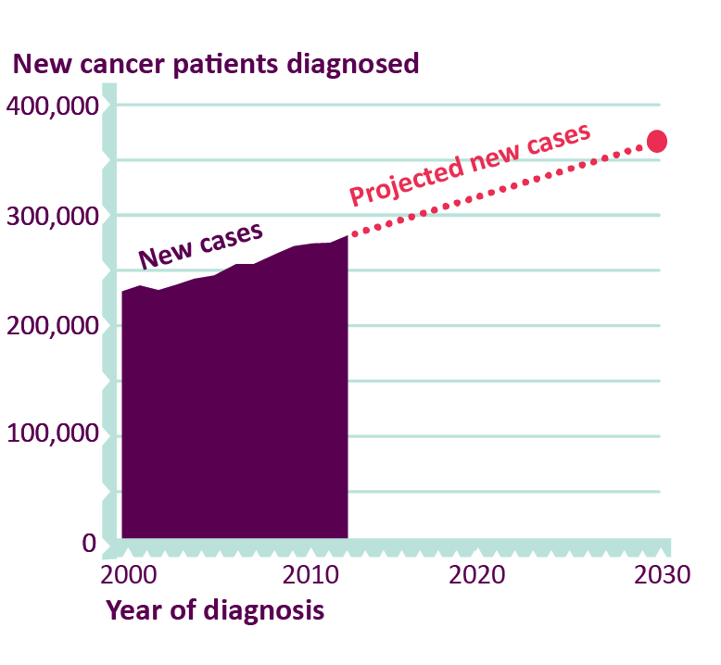
Cancer cases are rising as our population ages
In 2013, 280,000 new diagnoses
80,000 additional cases in 2030
Notes:
Start with some background and the scale of the challenge first.
In 2013, there were around 280,000 new diagnoses, a number which has been growing by around 2% per annum, i.e. around 5,000 - 6,000 additional new cases each year.
In England, according to current trends, we can therefore expect to see a further 25,000 to 30,000 new diagnoses each year by 2020, rising to 80,000 additional cases each year by 2030.
These figures emphasise the need to plan now for the increased demand we can expect to see, if outcomes are to be maintained or improved.
The continuing rise in cases is in part due to the ageing and growth of the population, a result of the overall success of the healthcare system in tackling premature mortality over the last 50 years as people are less likely to die from other conditions, such as cardiovascular disease. 90% of all cancers are diagnosed in people over the age of 50.
But it is also because our changing lifestyles are increasing our individual risk; prevention efforts have, as yet, been unable to stop or reverse this trend at an overall level.

Slide 4
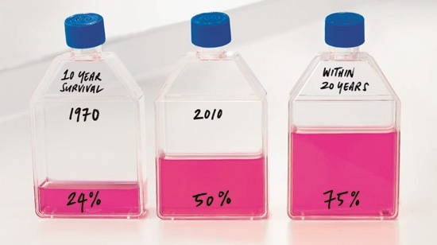
CRUK’s Survival ambition
Notes:
Back in 1970 you had a 1 in 4 chance of 10 year survival, this is currently 1 in 2
We want to accelerate our progress and see three quarters of people surviving the disease by 2034.
Major part of delivering this is our ED ambition that: 3 in 4 people diagnosed at an early stage (stage 1 or 2) by 2034

Slide 5
We still don’t compare well with other countries, whose systems are also improving
Source: Walters et al. (2015) Is England Closing the international gap in cancer survival?
Notes:
A recent study showed us that although cancer survival in England has improved, it still remains lower than in other comparable countries - we need to act now
The data shows us that cancer survival across all countries has improved between 1995 and 2009, but broadly speaking, survival remained lowest in England and Denmark. To add to this, in 2010-2012 cancer survival in England was still generally lower than had previously been in the other countries between 2005-2009. In other words – we haven’t yet caught up!

Slide 6
One year cancer survival across Thames Valley CCGs

Slide 7
Notes:
As you’re all aware, cancer can be diagnosed through various routes. This is an interesting infographic showing the proportions of cases diagnosed through each route, and also the staging
Around 5% of cancers are diagnosed via screening, and these are generally early stage
Conversely, around 20% are diagnosed in an emergency setting and these are more often likely to be late stage
What we are ultimately aiming for is for more cancers to be identified via screening or 2wws

Slide 8
Routes to Diagnosis
All Malignant Neoplasms (excl. NMSC) | Screen detected Two Week Wait GP referral Other Outpatient Inpatient Elective Emergency presentation Death Certificate Only Unknown
Thames Valley SCN | 6% 29% 24% 12 4% 19% 0%
England | 5% 30% 26% 10% 2% 22% 0%
 | Unknown : 4-6 %
Source: NCIN Routes to Diagnosis

Slide 9
Causes of death <75
1
Circulatory Disease
Cancer
Other
Liver
Respiratory
2
Cancer
Other
Circulatory Disease
Respiratory
Liver
3
Circulatory Disease
Cancer
Respiratory
Liver
Other
4
Cancer
Circulatory Disease
Other
Respiratory
Liver
Which do you think is the correct column?
(high to low)
Notes:
Quick quiz – to get them thinking and discussing amongst themselves. Starting with 1 as the biggest cause of death in the under 75s which column shows the correct order

Slide 10
Causes of death <75
1
Circulatory Disease
Cancer
Other
Liver
Respiratory
2
Cancer
Other
Circulatory Disease
Respiratory
Liver
3
Circulatory Disease
Cancer
Respiratory
Liver
Other
4
Cancer
Circulatory Disease
Other
Respiratory
Liver
Which do you think is the correct column?
(high to low)
Notes:
Quick quiz – to get them thinking and discussing amongst themselves. Starting with 1 as the biggest cause of death in the under 75s which column shows the correct order

Slide 11
https://www.gov.uk/government/uploads/system/uploads/attachment_data/file/307703/LW4L.pdf
Notes:
Cancer strategy for England in July 2015, developed by an Independent Cancer Taskforce (on which RCGP was represented), presents a vision for cancer control in the next five years.

Slide 12
Cancer Practice profiles
Produced by Public Health England
Data at a practice and CCG level is available online
Not used for performance management purposes
Useful data to review at a practice level
Various metrics including:
Demographics, cancer incidence, cancer prevalence,
Screening uptake for the three national programmes
2ww data, conversion rates etc
https://fingertips.phe.org.uk/profile/cancerservices
Notes:
We want to introduce you to practice profiles – these are produced by PHE and available online. They show data about individual practices and also CCG level data
They are not used for performance management (data from many sources, small numbers can skew data) but are useful to review at a practice level. They show data on a number of metrics e.g, - demographics, incidence, prevalence, screening uptake, 2ww data

Slide 13
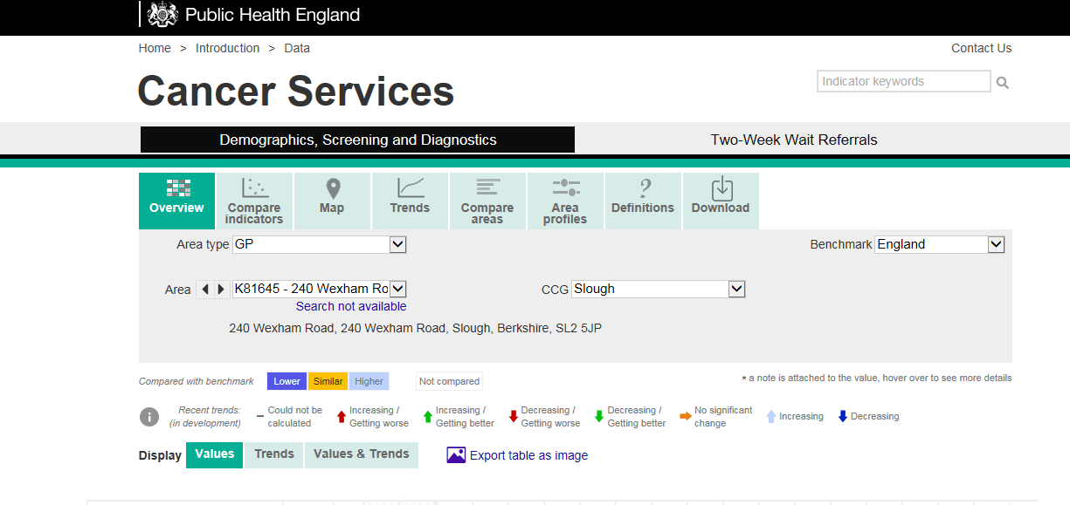
Notes:
Some discussion of cancer profiles produced by Public health england – if the wifi works and they can pull it up we can discuss it in some depth if not that’s fine I can just draw it to their attention and will give them a sample in their packs.

Slide 14
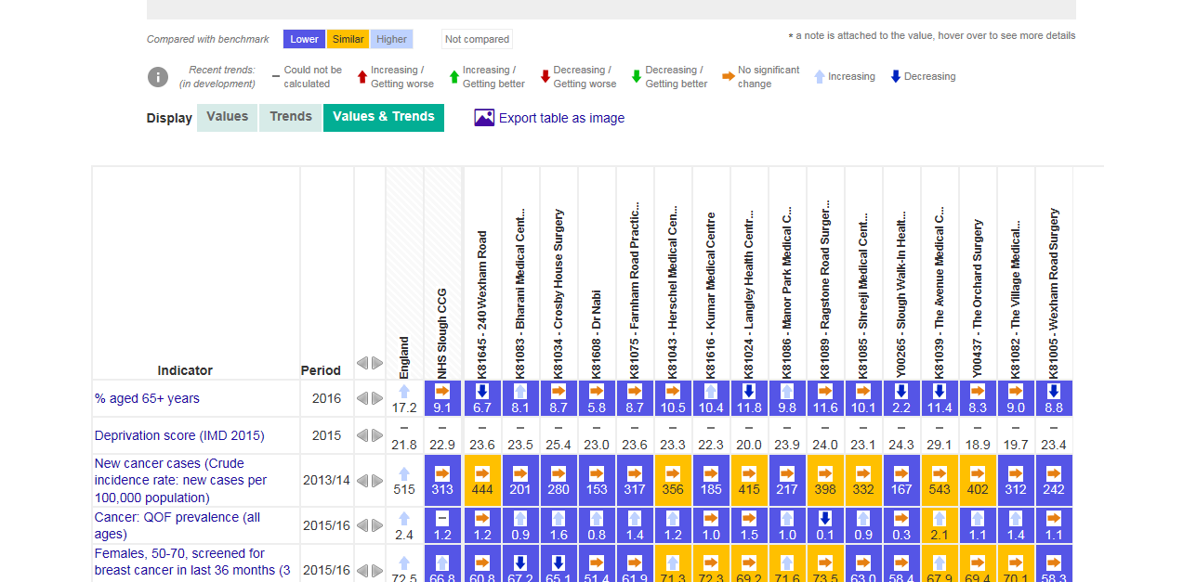

Slide 15
What are the 4 most common types of cancer?
Notes:
Breast, lung, prostate and Bowel

Slide 16
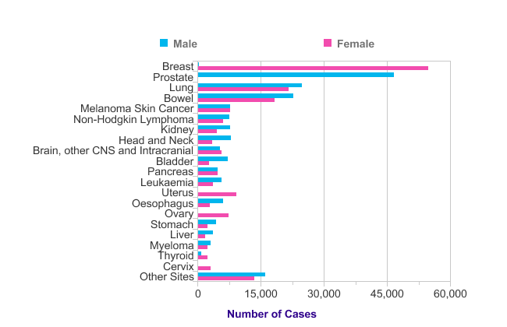
The Twenty Most Common Cancers: 2014
Number of New Cases, UK
Source: cruk.org/cancerstats
Notes:
Using data from 2014
Breast 55, 2221
Prostate 46, 690
Lung 46, 403
Bowel 41, 265

Slide 17
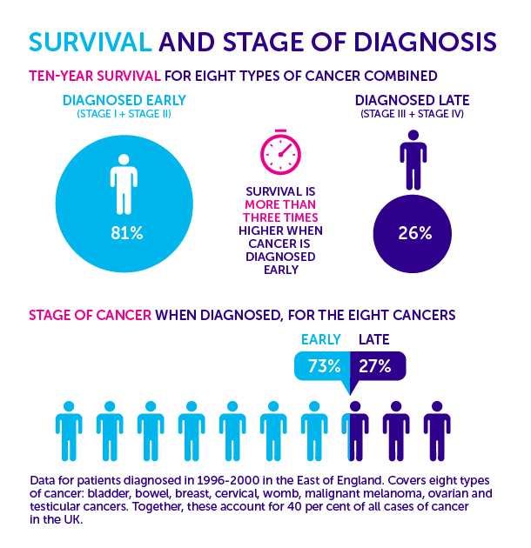
Over eight most common cancers, survival is more than three times higher when diagnosis is early
Data from the East of England for patients diagnosed between 1996-2000

Slide 18
NICE Guidance NG12 2015 Suspected Cancer: Recognition and Referral
Document is 378 pages long. Quick reference is nearly 100 pages.
Based on evidence from primary care studies ONLY.
Estimated to save 5000 lives every year upon implementation.
Should have a significant impact on practice.
Explicitly supports GPs using clinical judgement. ‘These recommendations are not requirements’

Slide 19
More direct access to investigations for GPs.
Upper GI endoscopy
CT abdo
Brain MRI
These guidelines are now based on clinical features with a > 3% PPV of cancer. Previous threshold was 5%. Concerns of over-investigation and over-diagnosis.
Direct correlation between propensity to use urgent referral pathway and reduced mortality.

Slide 20
Thrombocytosis and Cancer
Paraneoplastic thrombocytosis is associated with many solid tumours e.g. GI, lung, gynae, and associated with reduced survival.
Platelets > 450 is an added clinical factor in suspected ca.
Correlates with increasing evidence that aspirin may improve cancer survival and reduce mets. Particular benefit in prevention of lower GI ca. Cancer protection after 3 years of low dose aspirin, reduced cancer mortality after 5 years of low dose aspirin.
Aspirin is now recommended for age 50-59 for colorectal ca prophylaxis in draft US Preventative Task Force.
No such guidelines in the UK yet, but evidence from Add-Aspirin trial in UK.

Slide 21
Faecal Occult Blood (FOB) and Faecal Immunochemical Tests (FIT)
FOB detects haem, FIT detects globin. FIT has better sensitivity.
Recommends use as a diagnostic test in certain situations, e.g. change in bowel habits/Fe def anaemia without PR bleeding. And 2ww if +ve.

Slide 22
DRE and PSA
Recommended in any man presenting with LUTS or ED

Slide 23
Specific Cancers
Pancreas – Age > 60. Wt loss with any GIs/back pain/new onset DM.
Mesothelioma – Routinely ask about asbestos exposure
Lung – Acknowledge false –ve CXR. Discuss with radiology for CT if still clinically suspect.
Ovarian –Check Ca-125 with persistent or freq urinary sx, new IBS.
Brain – Headache does not feature. In primary care the risk of brain tumour with headache presentation is 0.09%.
Leukaemia – urgent FBC in unexplained fever/rec infections, bruising, bleeding, petechiae, unexplained bone pain.

Slide 24
BREAK
Notes:
May be insert 15 minute break here?

Slide 25
Safety Netting

Slide 26
Safety Netting
Regarded as “best practice” in relation to cancer diagnosis in non-specialist settings
Aim to ensure patients do not drop through the healthcare net but are monitored until symptoms are explained.
Clinicians might ask themselves when they make a working diagnosis: (Roger Neighbour)
If I’m right what do I expect to happen?
How will I know if I’m wrong?
What would I do then?
Effective safety-netting requires clinicians to share these thoughts with their patients
Notes:
Safety-netting is best practice, but there is an absence of evidence on whether it improves cancer detection and how best to do it in
patients with vague symptoms
• Explain the uncertainty about the cause of symptoms to patients, ensuring they understand why, when, and with whom they should
re-consult about which concerning symptoms
• Establish systems to ensure test results are reviewed by somebody with knowledge of cancer guidelines and that positive and negative
results are communicated to the patient promptly

Slide 27
NICE Recommendations
NICE includes three key recommendations in their guidance on suspected cancer:
Offer patients with low risk (but not no risk) symptoms review in an agreed timeframe
Healthcare professionals retain responsibility for reviewing and acting on the results of investigations they have requested
Be alert to the possibility of false negative test results and review patients even when tests are negative
Notes:
Low risk but not n o risk are symptoms that need to be paired with others to trigger a referral e.g. diarrhoea, abdominal pain and fatigue.

Slide 28
What are the challenges with symptomatic patients where cancer may be a possibility? What might cause delays?
Notes:
Optional
‘Shout-out slide’ – Brief discussion as a whole group
Explain that this sets out the different elements of the pathway that might contribute to delays in diagnosis. This includes:
Patient delays e.g. Not going to the GP straight away because of what the GP might find; fatalistic attitude; culture beliefs etc.
Primary care intervals e.g. Delays in referrals; delays in difficulty in recognising symptoms (vague symptoms); referring to wrong speciality; administrative errors etc.
System/secondary care e.g. Capacity issues; delays in diagnostics; administrative errors (e.g. in sending results)
28

Slide 29
Challenges with symptomatic patients where cancer may be possible
Relative infrequency of cancer
Symptoms are common and non-specific
Variable time course of evolution of clinical features
Cancer ‘survivors’²
Previous ‘all-clear’ or non-cancer diagnosis following symptomatic presentation³
People who are immuno-supressed⁴
It is inevitable that some patients with cancer will not be recognised or managed at initial consultation
Patient communication
1.Safety netting to improve early cancer diagnosis in primary care: development of consensus guidelines. Final Report. 4th May 2011.
Clare Bankhead et al; 2. Hippisley-Cox J, et al. BMJ Open. 2015; 5(3): e007825. doi: 10.1136/bmjopen-2015-007825; 3. Renzi C, et al.
BMJ Open 2015;5:e007002 doi:10.1136/bmjopen-2014-007002; 4. Vajdic CM, van Leeuwen MT. Curr Opin HIV AIDS. 2009 Jan;4(1):35-41.
Notes:
Optional
Explanation for ‘The patient interval’
We know GPs face several challenges in making timely diagnosis of cancer, further highlighting the importance of safety-netting / Safety netting is a useful tool GPs can use to mitigate some of these challenges.
Cancer survivors: Just because a patient has had cancer before, this does not mean they will not get cancer again.
Additional information for reference 3: Over-reassurance and undersupport of patients after a false alarm can undermine help seeking in the case of new or recurrent potential cancer symptoms, highlighting the need for appropriate patient information when investigations rule out cancer. Over-reassurance from the previous ‘all-clear’ diagnosis leading to subsequent symptoms being interpreted as benign and unsupportive healthcare experiences in which symptoms were dismissed, leaving patients concerned about appearing hypochondriacal or uncertain about the appropriate next actions. The evidence suggested that the effect of a false alarm can persist for months and even years.
Patients who are immuno-supressed (i.e. weakened immune system due to medication following transplant or HIV infection)are more likely to develop cancer

Slide 30
Safety Netting Summary
Patient communication
GP consultation
Practice systems
Safety netting to improve early cancer diagnosis in primary care: development of consensus guidelines. Final Report.
4th May 2011. Clare Bankhead et al.
Notes:
Provide background: In addition to newly published NICE guidance (around reviewing symptomatic patients that do not quite meet the criteria for referral), introduce Oxford University Safety Netting research (commissioned by DH in 2011): Series of safety-netting recommendations developed by GPs (following real GP experience) divided into three key elements:
specific actions to be communicated to patients; 2) actions that GPs should take during or shortly after the consultation 3) procedures that should be implemented at the Practice level. All of which will be included in this module.
Although much of the guidance may seem obvious to most GPs, this guidance has been developed following real GP experience, and patient delays resulted because systems were not in place, or knowledge was lacking.

Slide 31
Reflection on current safety-netting practice
Notes:
Introduce workbook and carry out reflection exercise (Boxes 1-3 from accompanying workbook)
Allow 10 – 15 minutes for this.

Slide 32
Scenarios for discussion
Notes:
Series of scenarios for discussion, adapted from real life examples (SEAs shared and what GPs have told us)
Mention that these are not about the details of the clinical aspects, but more about practical aspects……
Introduce scenarios – opportunities to implement safety netting activity, put up key questions on flipchart
Show each scenario and give participants 10 mins to work in small groups to identify what approaches could be used and work through questions
For each scenario:
Get each group to feedback and invite comment from other groups
Show summary slide with key approaches from the guidelines
Show pathway – key recommendations

Slide 33
Scenario 1
Patient presents 3 times to 3 GP’s with 3 related symptoms (low risk but not no risk symptoms) and hence is not referred on any of these single occasions.
The patient is subsequently diagnosed with cancer.
Notes:
Examples of ‘low risk but not no risk symptoms’ include constipation, diarrhoea, abdominal pain. These tend to have to be paired with others to trigger referral

Slide 34
Have you come across a similar situation to this?
What did you/would you do?
What actions would/did you take in relation to:
Patient communication
GP consultation
Practice processes
Notes:
Notes on flipcharts
Put up 3 key questions in flip chart
Additional questions for GPs:
What could have prevented a patient in this scenario slipping through the net?
Use of clinical system to link symptoms: How do you use the clinical system to ensure different GPs can link symptoms and act on previous consultations (including out of hours consultations)? Do you code symptoms as well as diagnosis? Safety advice documented in notes?
Are Locums confident & trained in coding / using the clinical system? Are locum packs given out?
What do you do to highlight pts that need reviewing (low risk but not no risk) e.g. Task, reminder too yourself, coding, patient note (which an be seen by other members of staff)?
Use of RATs to assess a combination of low risk symptoms - would a Locum / new doctor benefit from having a RAT available?
However, not all doctors like using RATs [Reference: “Implementing a QCancer risk tool into general practice consultations: an exploratory study using simulated consultations with Australian general practitioners” PP-C Chang, D.Glance, J.Walker, F M Walter and J D Emery. Br J Cancer. 2015 Mar 31; 112(Suppl 1): S77–S83]. The paper concludes that not all doctors like using risk assessment tools – and that interpretation of presenting symptoms vary. It also concludes that doctors have a strong belief in clinical intuition.

Slide 35
Guidelines
NICE guidelines¹:
Consider ‘patient-initiated review if new symptoms develop or the person continues to be concerned’
Safety netting summary²:
GPs should consider referral after repeated consultations for the same symptom where the diagnosis is uncertain (e.g. 3 strikes and you are in)
If symptoms do not resolve, further investigations should be conducted even if previous tests are negative
Practice systems should be able to highlight repeat consultations for unexplained recurrent symptoms/signs
Suspected cancer: recognition and referral NICE guideline. Published: 22 June 2015; 2. Safety netting to improve early cancer
diagnosis in primary care: development of consensus guidelines. Final Report. 4th May 2011. Clare Bankhead et al.
Notes:
Key guidelines recommendations relevant to scenario 1

Slide 36
Notes:
Show sections relevant to scenario 1 (green circle)

Slide 37
Scenario 2
A 40 year old Romanian patient, a single parent of 4 young children attends with symptoms which could indicate cancer and you make a 2ww referral. You ask her to make an appointment with you in a month’s time to review the outcome.
A month later you realise she has not returned and you have not yet seen any results. The receptionist makes contact and finds she did not attend the 2ww appointment as her children were ill. She is not clear why she has been referred to the Hospital. You make a further referral and stress the importance of attending.
A month later you note that you have still not had a report from the Hospital about this patient.
Notes:
Build - Reveal 1st bullet only.
Questions for GPs (to be posed after 1st bullet), to be conducted as a quick discussion:
What do you communicate to your patient? Do you tell them cancer is suspected? Patient referral leaflet
Do you use Choose and Book or fax? If C&B who does it? 1 system across practice ideally
How know patients attend 2WW appointments?
Do you know % of your patients that attend 2WW appointments? (Add CCG average if available)
What systems/processes do you have in place in your practice for recording and following-up on your 2WW referrals / investigations ?(e.g. log or electronic
Systems)
GPs still maintain degree of responsibility for referral – shared primary/secondary care

Slide 38
Have you come across a similar situation to this?
What did you/would you do?
What actions would/did you take in relation to:
Patient communication
GP consultation
Practice processes
Notes:
Notes on flipcharts
Put up key questions in flip chart
Additional questions for GPs:
What would you do next? Written / verbal action?
What do you think could have prevented a patient in this scenario slipping through the net?
What do you have in terms of translation facilities within CCG?
What systems/processes do you have in place for checking that patient has attended investigations/2ww appointment, results received, action taken on results? etc
Do you have a system for picking up non event?

Slide 39
Guidelines
Safety netting summary:
If a diagnosis is uncertain, give a clear explanation for the reasons for tests or investigations (e.g. to exclude the possibility of serious disease or cancer)
Uncertainty should be communicated to patient if diagnosis uncertain.
Communicate to patient who should make a follow up appointment with the GP, if needed (usually requesting the patient make the appointment, sometimes the doctor)
GP should ensure that the patient understands the safety netting advice
Additional measures should be taken to ensure patients with language/literacy barriers fully understand the safety netting advice
Safety net advice should be documented in the medical notes
Practices should ensure that current contact details are available for patients undergoing tests/investigations or referrals
Practice staff involved in processing /logging of results should be aware of reasons for urgent referral under the 2 week wait
Safety netting to improve early cancer diagnosis in primary care: development of consensus guidelines. Final Report.
4th May 2011. Clare Bankhead et al.
Notes:
Summary of the key points from guidelines for whole scenario
Practical examples (Ref: Guide to Coding and Safety netting, Dr Bhuiya A):
‘Documenting safety-netting advice in the notes:’
Examples of safety-netting codes which can be used:
Safety netting code READ CODE
Follow up visit 9N7B
Follow up appointment offered 9n7M
Asked to come-investig result 9N75
Follow up 9c0H
Follow up arranged 8H8
Patient asked to make an appointment 9N7C
Active monitoring 9Ok4
READ coding all urgent cancer referrals ‘as Fast Track Cancer’

Slide 40
Notes:
Show sections relevant to scenario 2 (green circle)

Slide 41
Cancer Screening Programmes

Slide 42
Notes:
There are 3 national screening programmes in the UK.
Screening is for healthy people without symptoms
There are risks as well as benefits for all cancer screening programmes so its important that people get all the information they need to make an informed decision about screening.

Slide 43
Cancer screening programmes
Bowel screening
Men and women aged 60 to 74 invites up to 75
Testing kit received in the post.
6 stool samples needed.
Breast screening
Women aged 50 to 70.
Women over 70 can request screening.
Mammography
Cervical screening
Women aged 25 to 64 in England
Every 3 years up to age 49, then every 5 years
Cytology
National target 60%
National target 80%
National target 80%
Notes:
Will include something on local coverage rates in Berkshire.
People who are under the age CANNOT opt in to screening but people who are over the age CAN opt in to Breast and Bowel screening.
National Screening Targets:
· The breast screening uptake target is 80% (with a minimum target of 70%) and this is consistent across all countries
In some areas, women aged 47-73 years are being invited to attend as part of a trial.
· The cervical cancer screening uptake target is 80% and this is consistent across all countries
· The bowel cancer screening uptake target is 60% for England, Wales and Scotland

Slide 44
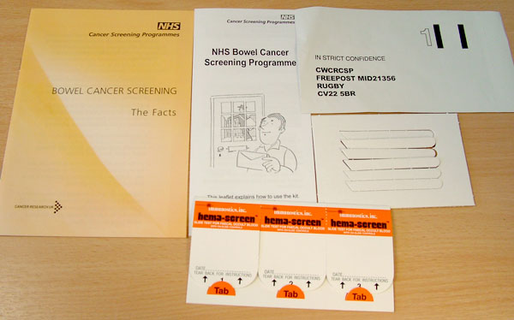
Bowel screening kit
Notes:
LETTERS ARE SENT TO THE PERSON BEFORE AND AFTER FOBT IS SENT *England only*
Bowel screening invitation process.
• Patient receives 1st invitation letter to screen on or close to their 60th birthday
• Approximately 2 weeks later patient receives FOBt kit in the post (this is the quiz at the end so make sure everybody understands)
• 4 weeks after 2nd reminder letter is sent
• The ‘screening episode’ is closed after 13 weeks if not responded to (13 weeks from time received FOBT)
• The patient will be recalled for screening in 2 years time
• A patient that has not been screened within 2 years can telephone anytime to request a kit
UK study- Talk about study from British Journal Of Cancer (Hewitson et al 2011) about what helps [Note - give out the handouts of this study if people ask]
-GP endorsement was effective in increasing uptake. Shown to increase uptake by 6% *Caveat- expensive and difficult to facilitate
Evidence to say that if someone does the first one, they will continue to do it.
Question - ‘What could you do?’ Texts, calls, letters? Poo Catching devices? Poo Catcher?
[Note – Capture answers on flipchart]
Discussion –
What affects the uptake? Capture on flipchart paper.
How can you affect these results?
Hewitson trail.
Key points:
Hewitson trail
Importance of getting patient’s to do the first FOBt

Slide 45
Patient reports difficulty in completing the FOB test
Practice staff are unsure about who isn't completing the FOB test
Patient is unable to catch sample
Patients don’t understand the test
There are cultural barriers
Obstacles in Bowel screening
Patients are unsure about who to call to arrange bowel screening
Low perceived risk of getting bowel cancer
Patients are worried about finding cancer
Patients procrastinating when the FOB test /appointment letter comes through
Notes:
Discussion – Why do you think people do not get screened? What do you imagine they think when they get the screening kit in the post?
[
Key points:
Get attendees to think like someone who has received an FOBt and think abut the problems/concerns they face.
Get attendees thinking about solutions to these concerns

Slide 46
Practical tips
TRAINING
Provide training to all of your staff
KNOW THE TEST
Being familiar with the FOBt test kit, can help practice staff explain it to patients.
DISPLAY SCREENING INFORMATION
Information can be displayed in the practice to alert people to bowel screening
SIGN UP TO RECEIVE ELECTRONIC RESULTS
These are available for bowel cancer screening and can be requested from the Bowel Cancer Screening Hub. Automatically READ coded.
USE PRACTICE DATA
You could check that the contact details of people aged 60 and over are accurate
Consider checking how your practice’s uptake and coverage compares with local and national averages.
Notes:
What can you do in your practice to encourage uptake
Mention posters and cards in their packs

Slide 47
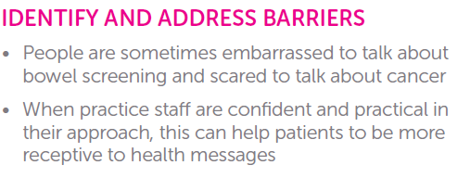
GP ENDORSEMENT
For details of more interventions see Cancer Research UK’s Evidence and Intelligence Hub: http://www.cancerresearchuk.org/health-professional/early-diagnosis-activities/bowel-screening-projects-and-resources/evidence-on-increasing-bowel-screening-uptake
Notes:
UK study- Talk about study from British Journal Of Cancer (Hewitson et al 2011) about what helps
-GP endorsement was effective in increasing uptake. Shown to increase uptake by 6%. Note: London and other areas are introducing GP banner on their invitation letter.
Evidence shows that people who have done the test once are more likely to do it again at a future invitation round.

Slide 48
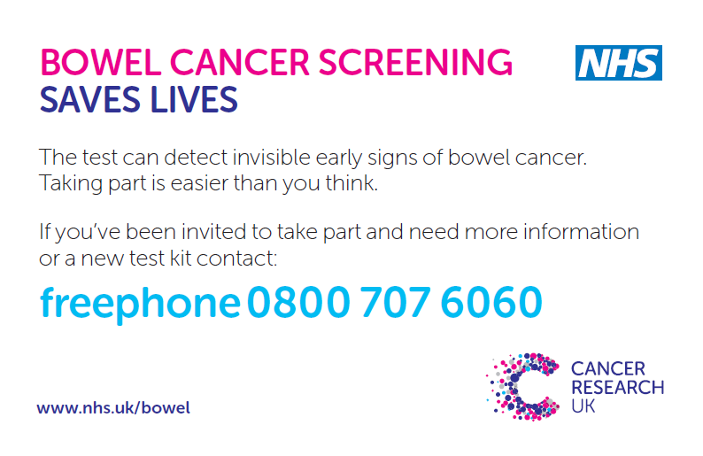
Bowel Screening
Notes:
Order via publications link: http://publications.cancerresearchuk.org/search-results/search-results.html?filter_type=6&filter_action=0&filter_name=SearchTerm&filter_value=card&x=0&y=0

Slide 49
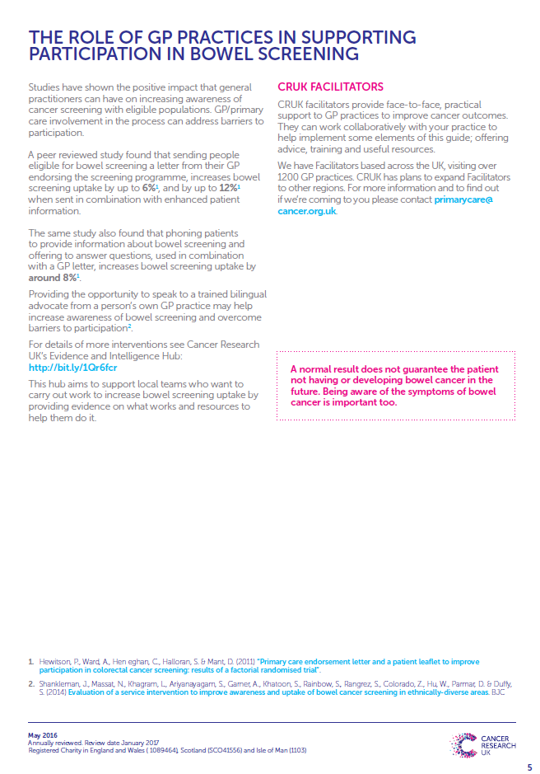
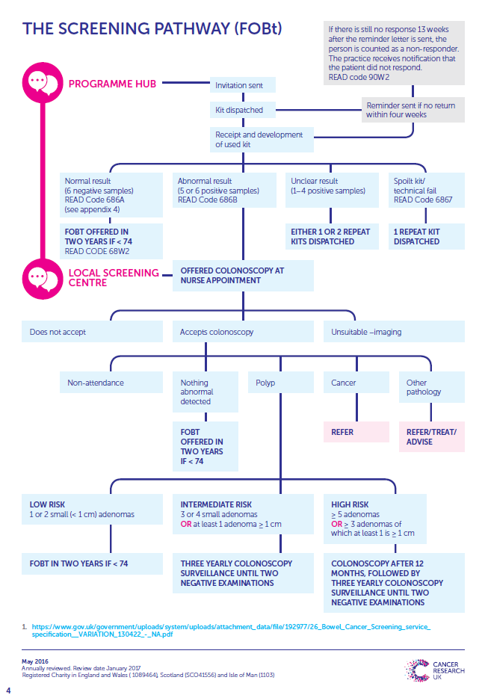
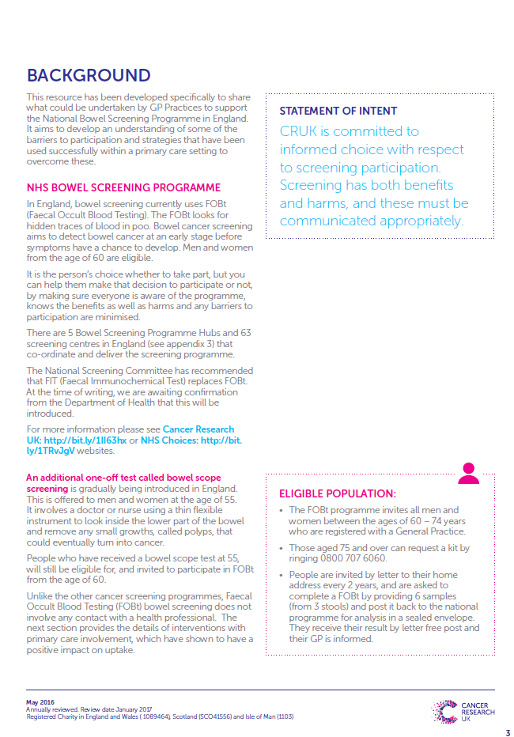
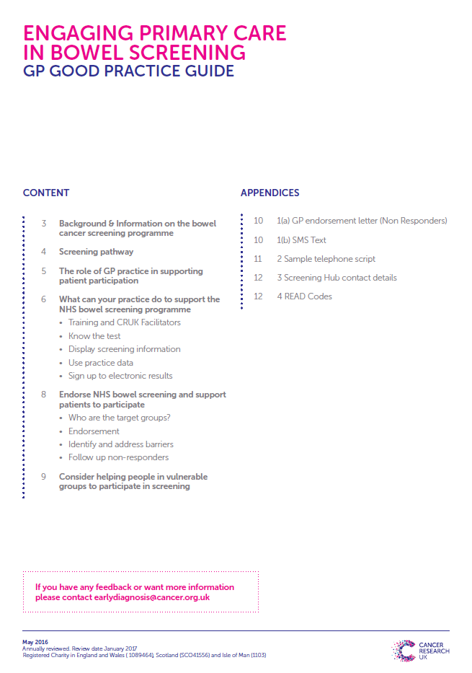
SCREENING ADVICE AND RESOURCES
Advice on increasing uptake and overcoming barriers to screening
Bowel screening resources
GP Good Practice Guide
Bowel screening information cards
How to do the kit: animation video

Slide 50
Some Useful tools and Resources and sources of patient info
Notes:
I’ll insert some examples here of useful tools and resources that are available from RCGP and CRUK and Macmillan

Slide 51
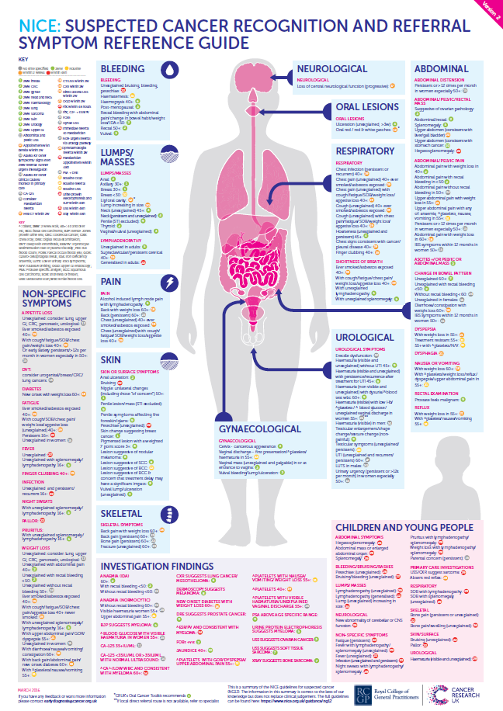
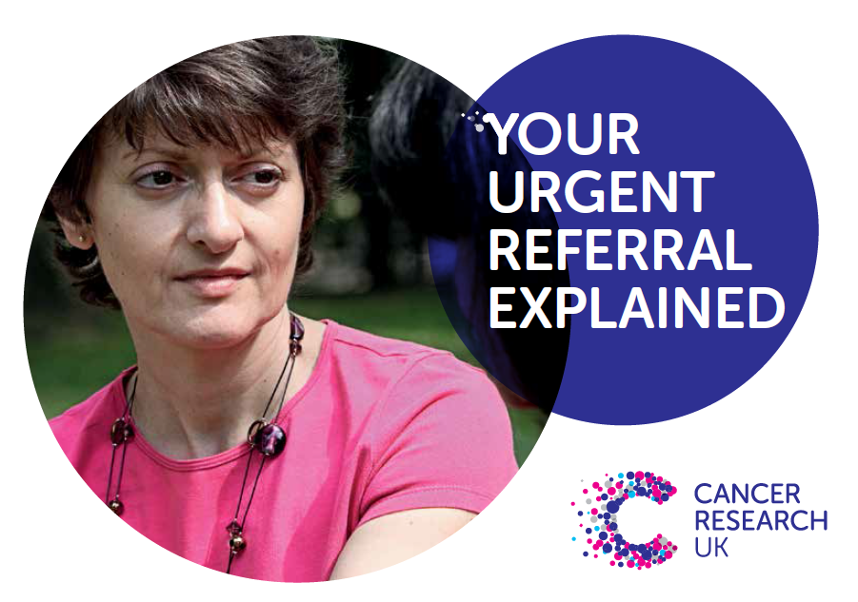
RECOGNITION AND REFERRAL TOOLS
Referral guideline summaries
Doctors.net resources
Cancer Insight newsletters
Oral Cancer Recognition Toolkit
Advice on CDS tools

Slide 52
Early diagnosis audit tools
RCGP/ NCAT Cancer Audit Tool
The Royal College of General Practice and National Cancer Action Team audit tool for cancer provides a method of identifying and reviewing cancer diagnoses.
Significant Event Audit template
The RCGP Significant Event Audit template is a useful way of recording and reflecting upon the events surrounding a cancer diagnosis.
www.cancerresearchuk.org/health-professional/learning-and-development-tools/audit-tools
Notes:
Refelection on previous cancer cases can be very useful. There are several tools available to help with this.
Talk through RCGP audit tool and SEAs

Slide 53
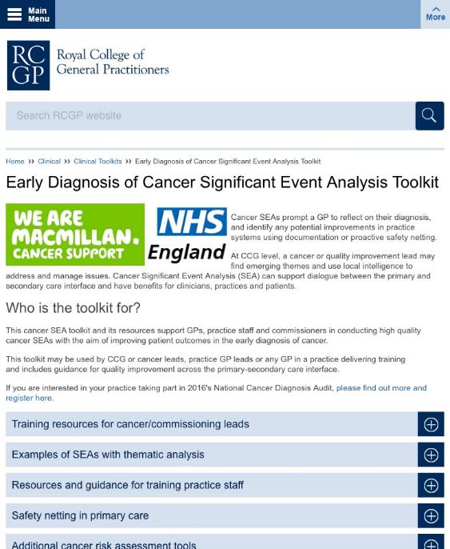
Notes:
This is a helpful resource provided by RCGP – an SEA toolkit. It provides advice and resources for undertaking meaningful and useful SEAs
This leads on to our next (and final) section
Louise will now talk about a project that we have been working on across the Thames Valley over the past two years

Slide 54
Thank you for listening
Bridget.england@cancer.org.uk
Tel: 07500 881933

