Slide 1
Genetics Wow!
Dr Elena Hilton MRCGP

Slide 2
Important for a GP
It has been estimated that at least one in ten of the patients seen in primary care has a disorder with a genetic component
There are three main themes of genetics in primary care:
identifying patients with, or at risk of, a genetic condition
clinical management of genetic conditions
communicating genetic information
Taking and considering a genetic family history is a key skill in identifying families with Mendelian disorders and clusters of common conditions such as cancer, cardiovascular disease and diabetes

Slide 3
Important for a GP
General practitioners (GPs) have a key role in identifying patients and families who would benefit from being referred to appropriate specialist genetic services
General practice plays a key part in discussing results from the antenatal and newborn screening programmes which are identifying carriers and people affected with genetic conditions
Genomic information is currently being utilised in the stratified use of certain medicines
Information about genetic susceptibility in common conditions (currently being gathered through research studies) is likely to offer additional information about risk factors to aid management

Slide 4
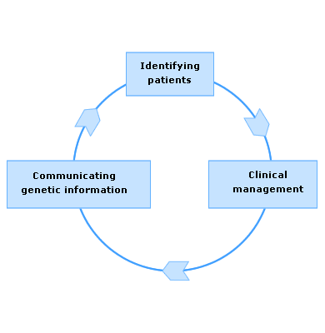
How can patients with or at risk of genetic conditions be recognised?
From a known genetic diagnosis or by recognising signs and symptoms of common genetic conditions (e.g. Huntington disease, cystic fibrosis, haemophilia)
Through a pattern of affected people in a family (which may suggest a single gene disorder or a clustering of cases of common diseases)
From the results of screening programmes (for instance carrier status for sickle cell disease through the newborn screening programme)

Slide 5
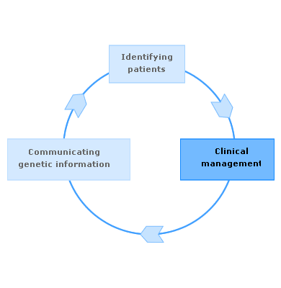
Clinical Management
Accessing information
Providing patient and family co-ordinated care and support

Slide 6
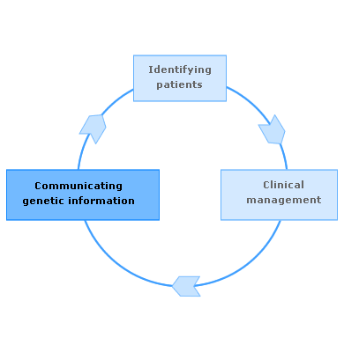
Communicating Genetic Information
Appreciating the emotional, ethical, legal and social impact of genetic information for a patient and their family
Communicating genetic information in an understandable way
Being non-directive and supporting informed decision making
Understanding consent and confidentiality issues

Slide 7
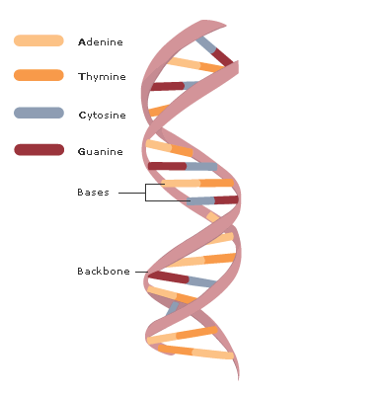
The DNA molecule forms a double helix:
Each of the two strands in the ‘backbone’
is made of deoxyribose sugars and phosphates
The ‘rungs’ are nucleotide bases. The four nucleotide
bases in DNA are adenine, thymine, cytosine and guanine (A T C G)
A binds to T and C binds to G, forming pairs from one side of the backbone to the other – ‘complementary base pairing’.

Slide 8
http://www.hhmi.org/biointeractive/dna-packaging

Slide 9
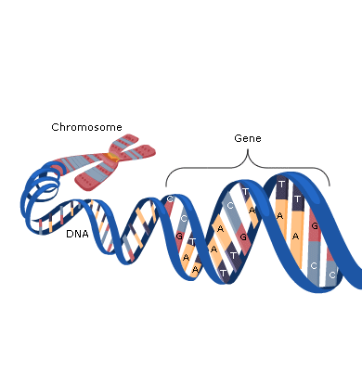
Genes are made of DNA and are the functional units of heredity.
A gene is a segment of DNA that encodes an RNA molecule.
Genes direct both the synthesis of proteins involved in cell structure, metabolism and cell communication and special RNA molecules which regulate gene expression

Slide 10
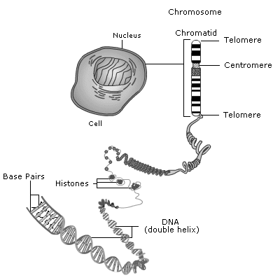
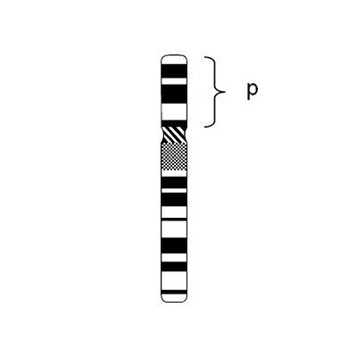
Chromosome structure
Chromosomes are found in the nucleus of cells.
Humans have 23 pairs of chromosomes in the nucleus - 22 autosomes and a pair of sex chromosomes (XX female; XY male).
The autosomes are numbered 1 to 22, from the largest to the smallest, by international convention.
We inherit one of each pair from our mother and one of each pair from our father.

Slide 11
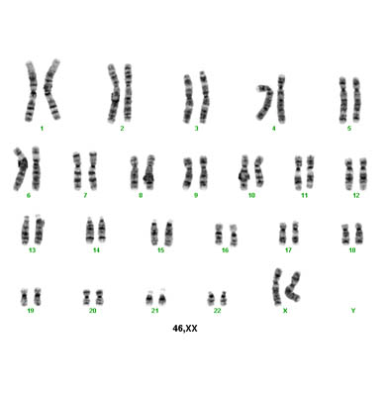
Karyotype
A karyotype is a picture of the chromosomes in the nucleus of a dividing human cell. They are used to illustrate numerical or structural chromosome anomalies.
46,XY normal male karyotype
46,XX normal female karyotype
47,XX,+21 female karyotype with 47 instead of 46 chromosomes; the extra chromosome is a 21 (Down syndrome)

Slide 12
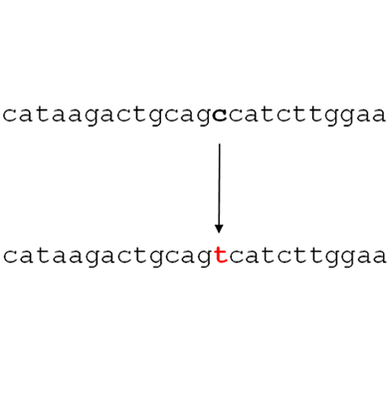
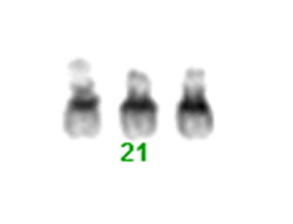
Mutations in single genes often cause loss of function (the gene product is missing or damaged so it does not function).
Variants in genes can cause alteration of function.
Chromosomal imbalance causes alteration in gene dosage (0.5 or
1.5 times the amount of gene product from one or three copies instead of the usual two).

Slide 13
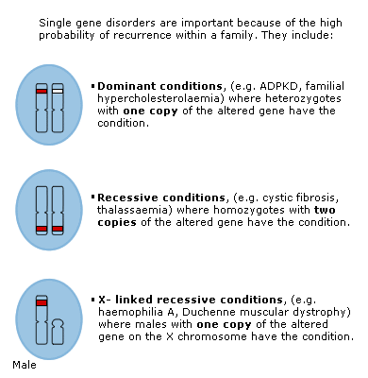
Classification of Genetic Disorders
Single-gene disorders - alterations in one gene

Slide 14
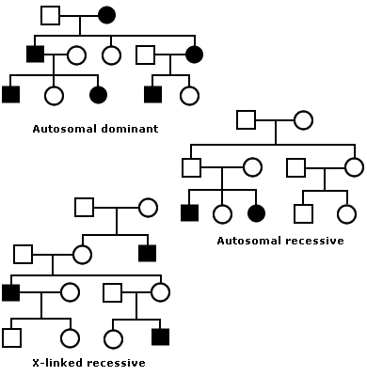

Slide 15
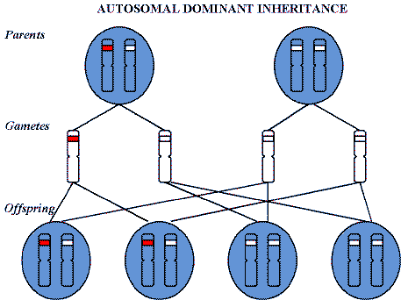
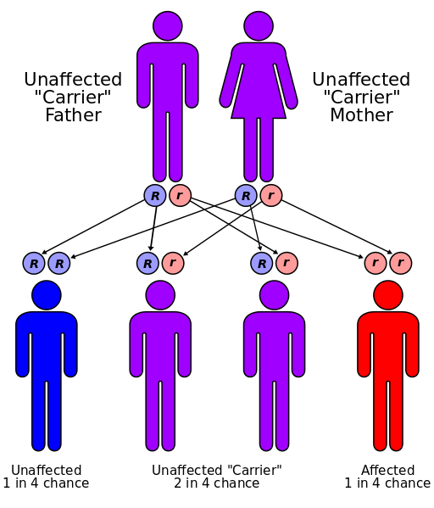
Autosomal Recessive Inheritance

Slide 16
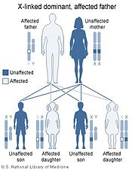
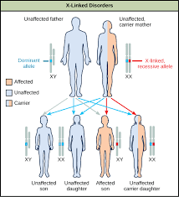
X-linked Recessive Disorder

Slide 17
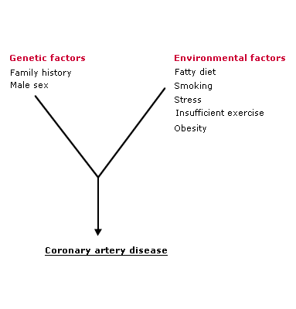
Multifactorial inheritance accounts for the majority of congenital malformations such as
spina bifida, and for adult onset disorders such as diabetes and coronary artery disease.
They are caused by a combination of the effects of several genes and the environment.

Slide 18
Chromosomal disorders - imbalance of many genes
Chromosomal conditions (e.g. Down’s syndrome, translocations) affect multiple organ systems at multiple stages in development because many genes are involved.
Chromosomal conditions are due to structural or numerical anomalies. The resulting chromosomal imbalance causes an alteration in gene dosage. For example, when there are three copies of normal genes (for example in trisomy 21), there would be 1.5 times the amount of gene products. When deletion of chromosomal material leaves only one copy of a gene remaining, there would be 0.5 times the amount of gene product.

Slide 19
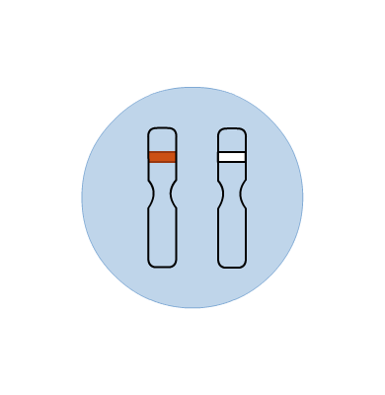
Brief summary of single gene disorders
One copy of the altered gene is sufficient to cause the condition (heterozygous)
Hypercholesterolemia
Adult polycystic kidney disease
Neurofibromatosis type 1
Huntington disease
Some familial forms of breast and colorectal cancer

Slide 20
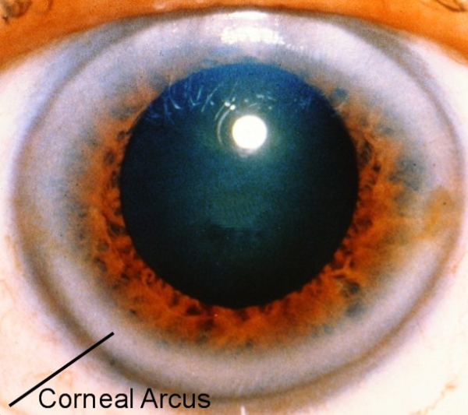
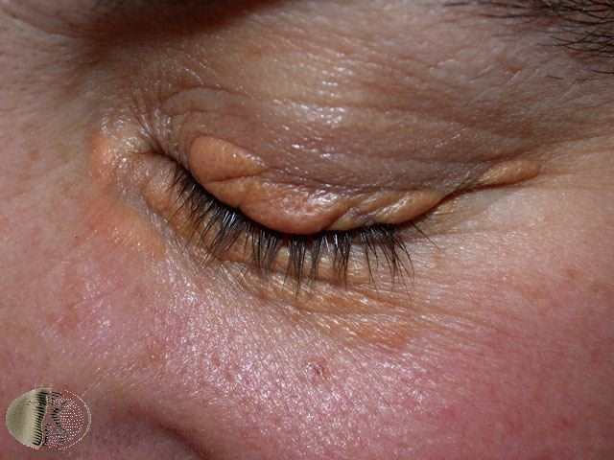
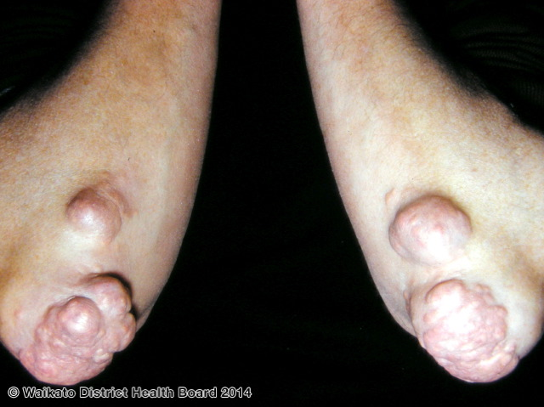

Slide 21
Familial Hypercholesterolemia - AD
Incidence
Familial hypercholesterolemia (FH) is common
(incidence 1:500 Northern European Caucasians and underdiagnosed)
Clinical Features
Premature coronary artery disease (typically fourth decade in men, up to ten years later in women)
Tendon xanthomata (virtually diagnostic)
Premature corneal arcus
Xanthelasmas
Genetic Basis
Each child of someone with an autosomal dominant condition has a 50 % chance of inheriting the gene alteration
As FH is common, sometimes both parents can have the condition. In this case each child has a:
50% chance of inheriting the gene alteration form either Parent, or
25% chance of inheriting the gene alteration from both parents
HOMOZYGOUS FH is life threatening!

Slide 22
Simon Broome diagnostic criteria for index individuals
Diagnosis of a person with possible FH if they have cholesterol concentrations as defined in Table 1 and at least one of the following:
Family history of myocardial infarction: aged younger than 50 years in second-degree relative or aged younger than 60 years in first-degree relative
Family history of raised total cholesterol: greater than 7.5mmol/l in adult first- or second-degree relative, or greater than 6.7mmol/l in child, brother or sister aged younger than 16 years.
Table 1. Cholesterol levels to be used as diagnositc criteria for the index individual¹
 | Total cholesterol | LDL-C
Child/young person | >6.7 mmol/l | >4,0 mmol/l
Adult | > 7.5 mmol/l | >4.9 mmol/l
¹Levels either pre-treatment or highest on treatment LDL-C, low density lipoprotein cholesterol

Slide 23
Management of FH
Primary Care Management
Family history of coronary artery disease at an earlier age than expected should be evaluated with a lipid screen
Particular care should be taken to look for clues that both partners could have FH, which can occur as the altered gene has a high frequency. If so, a child can inherit two copies of the altered gene, resulting in a more severe life-threatening condition with concerns about coronary heart disease in childhood
Secondary Care Management
Patients with familial hypercholesterolemia should ideally be managed under the care of a specialist at a lipid clinic

Slide 24
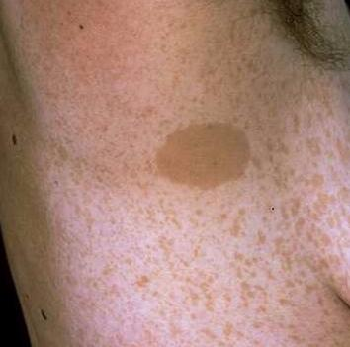
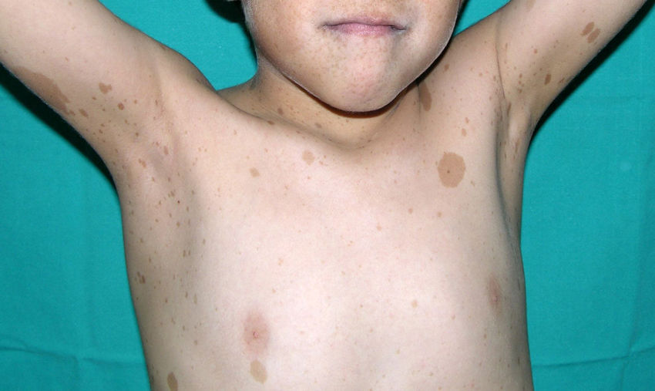
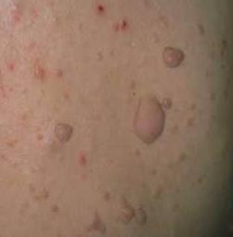
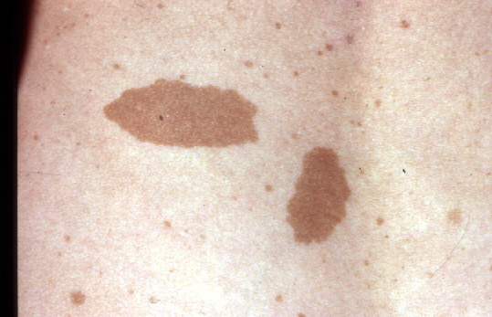

Slide 25
Neurofibromatosis
Clinical Features of NF1
NF1 is common (birth incidence about 1 in 2,500) with skin pigmentary changes and the development of benign tumours on nerve tissue anywhere in, or on, the body.
Primary Care presentation with multiple café au lait macules and/or neurofibromas
Primary Care Management and Referral
Surveillance should be instigated for: learning difficulties (usually mild) and scoliosis (in childhood)
Optic glioma
Benign or malignant tumours
Hypertension (secondary to pheochromocytoma)
Patients with NF1 should be reviewed at least annually
children, usually by a paediatrician and ophthalmologist
Adults, usually by their GP
Refer to a clinical geneticist for confirmation of diagnosis and discussion of genetic implications

Slide 26
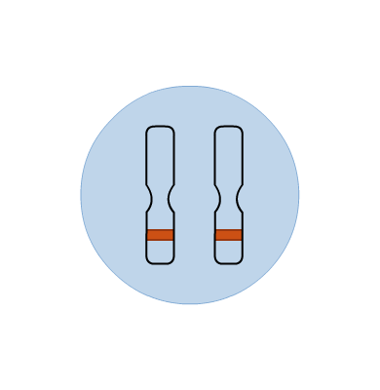
Autosomal Recessive Disorders
Both copies of the gene must be altered to cause the condition (homozygous); a person with one altered copy of the gene (heterozygous) will be a carrier for the condition.
Cystic fibrosis
Sickle cell disease
ß-thalassaemia
Haemochromatosis
Congenital adrenal hyperplasia
Congenital deafness
Alpha-1-antitrypsin deficiency

Slide 27
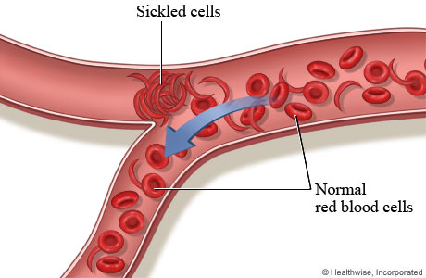
Sickle Cell Anaemia
Sickle cell anaemia is the most common inherited condition in England, affecting around 12,500 people.
This causes chronic haemolytic anaemia, and recurrent acute painful crises, which can be life-threatening.
Pain, chronic haemolytic anaemia and severe infections, usually beginning in early childhood
Caused by having two copies of the beta globin gene with the sickle mutation (HbS)

Slide 28
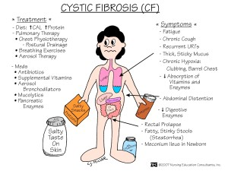
Cystic fibrosis (CF) is an inherited condition of the exocrine glands
CF is an autosomal recessive condition, owing to mutations in the CFTR (cystic fibrosis transmembrane conductance regulator) gene - essential for water and salt movement across cell membranes (thick secretions)

Slide 29
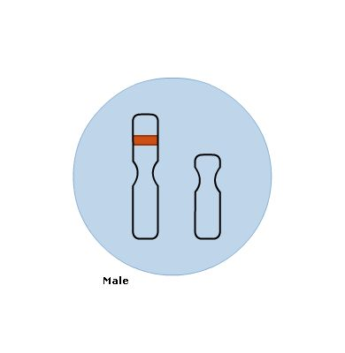
X-linked Recessive
One copy of the altered gene on the X chromosome is sufficient to cause the condition in males. A female with one altered copy of the gene (heterozygous) will be a carrier for the condition.
Affected people are males
Affected males in different generations
Affected males are related to each other through an unaffected female
The condition is not transmitted from male to male
Haemophilia
Duchene Muscular Dystrophy
Fragile X

Slide 30
Haemophilia A
Haemophilia A affects 1 in 5,000 males.
It is an X-linked recessive bleeding disorder caused by partial or complete deficiency of Factor VIII, the amount of residual clotting factor determining the severity.
Clinical Features
Bleeding can occur into joints and muscles, or be prolonged at wound sites. It can occur hours or days after an injury, and can continue for weeks if untreated. Spontaneous bleeding into joints must be treated to avoid permanent damage. Even minor head injury can lead to serious intra-cranial haemorrhage. Internal bleeds can be extremely painful.
Severely affected boys usually present when crawling begins, or due to finger-print bruises from normal handling leading to concerns about non accidental injury.
Mildly affected individuals may present following investigations for prolonged bleeding after tooth extraction or surgery

Slide 31
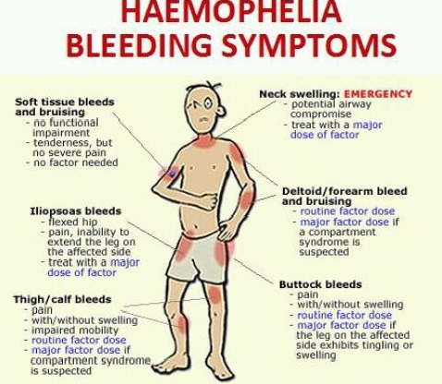

Slide 32
Duchenne Muscular Dystrophy
Duchenne muscular dystrophy affects 1 in 3-4000 males, is characterized by progressive muscle weakness and is caused by mutations in the dystrophin gene.
Clinical Features
Boys may present with delays in development, particularly speech and motor functions (walking >18 months). The ability to walk independently is lost typically in late childhood, eventually becoming wheelchair dependent
About 30 % of boys have a non-progressive mild learning difficulty
Complications of DMD include respiratory infections and respiratory failure, cardiomyopathy (considered to be almost universal), scoliosis and osteoporosis
Diagnosis
Consider DMD in boys with speech delay, weakness, falls and difficulty with motor skills (walking on tip toes, unsteady gait)
Examination may reveal muscle wasting, calf muscle pseudohypertrophy and lordosis
Many boys display the Gower sign: to rise from lying on the floor, they support their back muscles by putting their hands on their knees and thighs

Slide 33
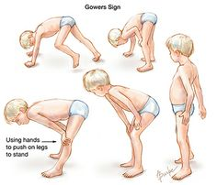

Slide 34
Management of DMD
Primary Care Management and Referral
Refer boys with delayed motor milestones to local paediatric services
Boys with DMD should be managed by the local paediatric neurology or neuromuscular service
Consider flu and pneumococcal vaccination
Secondary Care Management
CK level is more than 10 times normal
DNA for dystrophin analysis may detect a mutation which obviates the need for a muscle biopsy
Muscle biopsy if no dystrophin mutation has been identified
Echocardiograms and ECGs to detect cardiomyopathy and arrhythmias
Assessment for nocturnal hypoventilation
Referral should be made to a clinical genetics unit

Slide 35
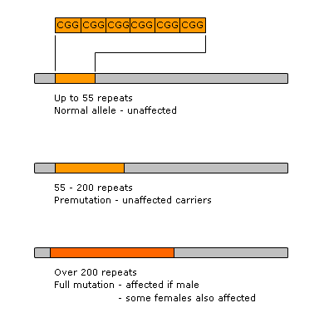
Fragile X chromosome
Fragile X syndrome is the result of the presence of multiple copies of a sequence of three bases (CGG) in an area of DNA associated with the gene.
The number of copies of this tri-nucleotide sequence determines the clinical presentation of fragile X syndrome as shown in the table and figure.

Slide 36
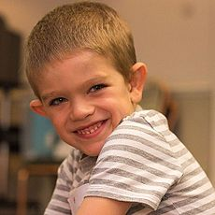
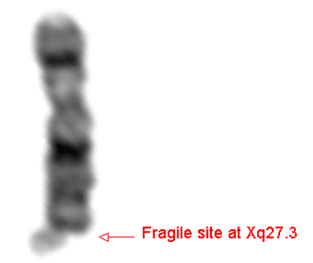
Most common cause of inherited learning difficulty; approximately 1 in 5,500 males show signs of the condition. The gene, FMR1, is located on the X chromosome.
Children and adults with fragile X syndrome have varying degrees of learning difficulty and behavioural problems including autistic-like features, language deficits, lack of motor co-ordination and hyperactivity, as well as emotional problems
Males tend to be more severely affected than females
Males with fragile X syndrome may show characteristic physical features, such as macrocephaly, prominent ears, long face, large jaw and enlarged testes
Seizures occur in 20 % of patients, usually in early childhood but usually resolve by adolescence

Slide 37
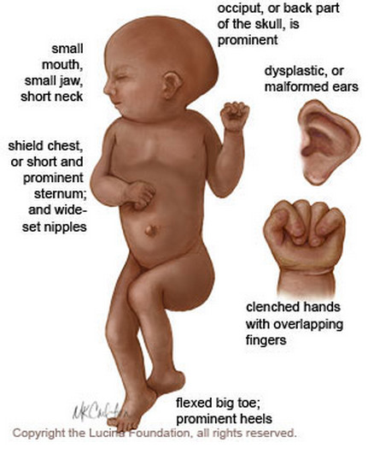
Chromosomal disorders -Autosomal Trisomies
Edwards Syndrome
Down Syndrome

Slide 38
Down Syndrome
Hypothyroidism
Ophthalmic disorders
Diabetes mellitus
Glue ear
Cervical spine instability
Coeliac disease
Obstructive sleep apnoea
Learning disability

Slide 39
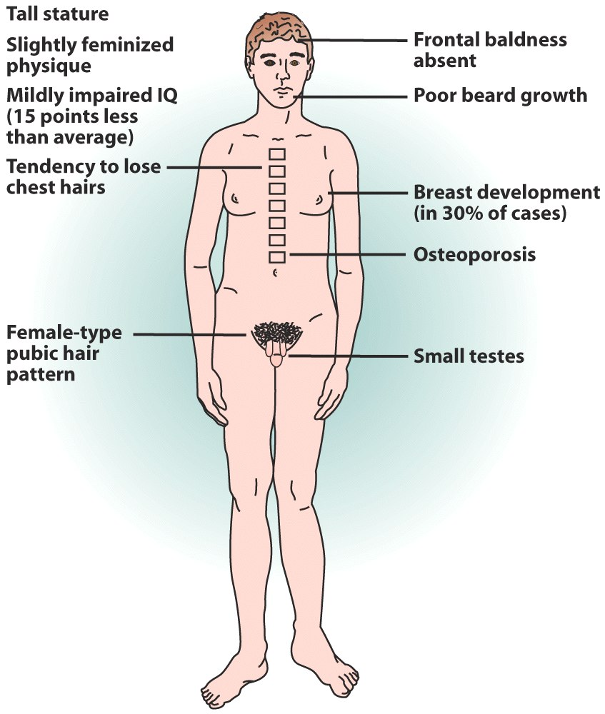
Chromosomal Disorders- Sex Chromosome Anomalies
Kleinfelter’s Syndrome
Turner’s Syndrome

Slide 40
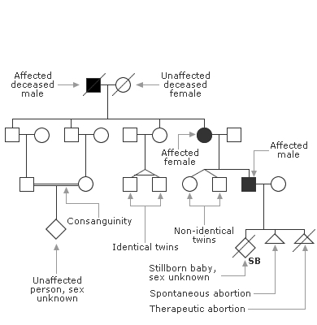
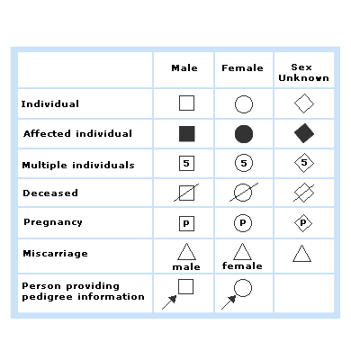
Taking and Drawing a Genetic Family History - Theory
Drawing a genetic family history, an important skill in primary care practice to identify patients with, or at risk of, a genetic condition.

Slide 41
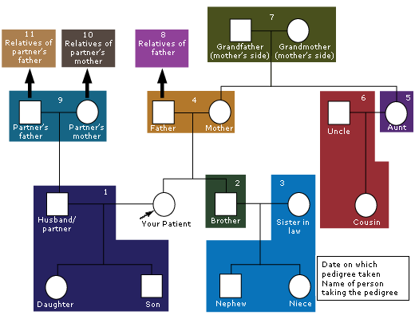
Partner and children
Siblings
Partners and children of siblings
Parents
One parent’s (usually the mother first) siblings
Partners and children of parent’s sibling
Grandparents from the chosen parental side
Other parent’s relatives (as per stages 5, 6 and 7)
Partner’s relatives, siblings and parents
Relatives of partner’s mother
Relatives of partner’s father

Slide 42
Angela, aged 32, has just moved into your area and attends for a prescription for the contraceptive pill. Whilst you are taking her blood pressure (which is raised), she mentions that as members of her family have adult polycystic kidney disease, she would like you to refer her for a renal scan. The result of her last renal scan, five years previously, was completely normal. As she is thinking of starting a family, she is also interested to know if her children would have a high probability of inheriting the condition.
Is the probability that Angela has ADPKD sufficiently high to warrant testing?

Slide 43
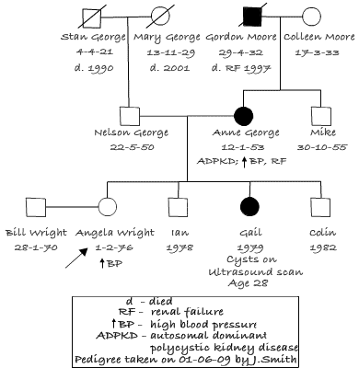
The family pattern is compatible with that expected with an autosomal dominant condition such as ADPKD.
The closeness of biological relationship between Angela and people in her family known to have the condition is important in determining her probability of being affected, and would influence the decision to refer.
As her mother is affected, the probability Angela also has ADPKD is one in two.

Slide 44
Genetic counselling
Genetic information needs to be given in an understandable way, remaining non-directive and supporting informed decision making
Good communication skills such as listening, empathy and attending to the patient’s agenda will maximise the interaction
Giving a diagnosis of a genetic susceptibility or condition can have the same impact as giving any other ‘bad news’ to an individual
It is important to understand issues of confidentiality of information when talking to families and discussing testing
Different attitudes, beliefs and language can impact on an individual’s understanding about inheritance
The emotional concern of a genetic diagnosis impacts not only the patient but also their immediate and extended family. For example, feelings of guilt about passing on a condition can be experienced

Slide 45
https://www.youtube.com/watch?v=qgs4vVeg1Sw
https://www.youtube.com/watch?v=umqElQeRvnk

