Slide 1
AKT preparation
Dr Nuzhet A-Ali

Slide 2
PROGRAMME
INTRODUCTION
STATS
LEARNING RESOURCES
RCGP AKT FEEDBACK
INTERACTIVE BIT

Slide 3
Simple math
Mean
Median
Mode
Effect of outliers

Slide 4
Hierarchy of evidence
(I-1) a well done systematic review of 2 or more RCTs
(I-2) a RCT- randomised to groups, diff rx, analyse results
(II-1) a cohort study ( prospective, following a well popn)
(II-2) a case-control study ( retrospective, matches cases/controls, look back for associations)
(II-3) a dramatic uncontrolled experiment
(III) respected authorities, expert committees, etc..
(good old boys sitting heroically at tables?)
(IV)....someone once told me- anecdotes, case report

Slide 5
Statistical Studies

Slide 6
Cross sectional studies
Observational
Describe how things are now- snap shot in time
Look at samples of populations or special groups
Do not have a separate control or comparison group
The term survey refers to the method
Key word: cross sectional
Various ways of selecting sample.
- hypothesis FORMING - cannot indicate cause & effect

Slide 7
ANALYTICAL STUDIES
Try to determine whether a factor really is involved in a disease or whether a particular intervention really does improve the treatment outcome .
This outcome could happen by chance

Slide 8
P- value
CHANCE - p = 1 in 20 (0.05).
> 1 in 20 (0.051) = not significant
< 1 in 20 (0.049) = statistically significant, unlikely to have occurred by chance
<1 in 100 – highly significant, highly unlikely to have occurred by chance
<1 in 1000 – very highly significant, very highly unlikely to have occurred by chance

Slide 9
Confidence intervals
This defines the range of values between which we could be 95% certain that this result would lie if this intervention was applied to the general population
The larger the sample- the smaller the interval- we are more sure of the result.
Is measured at the mean +/- 2 standard deviations.
(95% of the values lie between these values)
SD is the way of measuring how far from the average mean the values are spread

Slide 10
Case Studies, Reports
Observational studies
5 cases of male homosexuals in San Francisco with P carnii as cause of pneumonia, subsequently shown to have HIV infection and AIDS
Not determining a causal affect
Raise awareness

Slide 11
Case Control Studies
Select a group of patients with a characteristic – eg a disease – lung cancer
The characteristics of this set are then compared with a control group who do not have the disease being studied – but all all other respects must be as identical as possible.
Case studies look backwards in time at exposure to risk factor eg smoking - RETROSPECTIVE
Can use info to calculate odds ratio – odds of getting disease in exposed /odds of getting disease if unexposed

Slide 12
Odds Ratio – a ratio of risk in case control studies suggesting association not causation
E.g. In 100 patients with Lung Ca 60 are passive smokers
In 400 controls with no cancer 150 are passive smokers
Odds of having lung cancer as a passive smoker ie exposed to risk are 60:40
Odds of not having lung cancer as a passive smoker are 150:400
The odds ratio for passive smoking as a risk of lung cancer will be 60/40 = 2.5x
150/250

Slide 13
Odds Ratio
DISEASE
Cases Controls
exp pas sm Yes a b
n/e pas sm No c d
Odds Ratio = a/b divided by c/d
Disease
Cases Controls
(lung cancer)
EXPOSURE Yes 60 150
( pas.smoking) No 40 250
The odds ratio would therefore be 60/150 div by 40/250 = 2.5

Slide 14
Odds ratio
OR = 1: no association
OR > 1: possible association in this case possible association between exposure to passive smoking and getting cancer
OR < 1: protective effect
Further studies would then be indicated

Slide 15
Cohort Studies
A group is identified and then followed forward to see what happens
PROSPECTIVE
May have a comparison or control group , identified from start but not essential
Framingham study – started 1949– identified group of 5209 men and women aged 30-59 as a representative sample – identify RISK FACTORS associated with CVD

Slide 16
Cohort studies
 | Develop disease | Do not develop disease
Exposed to x | a | b
Not exposed to x | c | d
Absolute risk
"What is the incidence of disease attributable to exposure"
Answer = a - c.
Relative risk "How many times are exposed persons more likely to develop the disease, relative to non-exposed persons?" i.e. the incidence in the exposed divided by the incidence in the non-exposed. WE ARE LOOKING AT ONE THING COMPARED TO ANOTHER
This is expressed as a /a+b divided by c/c+d

Slide 17
Risk of getting cancer as a smoker compared to non smoker
In a Cohort study a ratio of risk
Cancer Not getting cancer
Smoke 10 600
Non smoker 1 800
Absolute risk= 9
Relative risk = 10/610 = 13.1x…
1/180

Slide 18
Eg Cohort Study
Deep vein thromboses (DVT) in oral contraceptive users. (Hypothetical results).
OUTCOME (DVT)
Yes No
Exposed ( on oral contraceptive ) 41 9996
Not exposed (not on o.c.) 7 10009
Absolute risk of 34
Relative risk of 6 ( 41/10037 divided by 7/10016)- significantly
large enough numbers to indicate the possibility of a real association between exposure and outcome.
However, the possibility of biases very often arises.

Slide 19
What is bias?
Selection bias
Observer bias
Participant bias
Withdrawal or drop out bias
Recall bias
Measurement bias
Publication bias

Slide 20
Bias (1)
Selection bias – select sicker patients to get the active or new Rx and fitter patients to get placebo or older Rx
Observer bias – if we know the patient has active treatment can subconsciously record health status as being better
Participant bias – e.g. in study looking at Gi bleeds in NSAID v non-NSAID users, the people who are not prescribed NSAIDs buy them OTC.
Withdrawal / drop out – if lose people from the study those left at the end may not be representative of those originally included, and their numbers may be very much smaller so affecting the validity and generalisability of event rates.

Slide 21
Bias (2)
Recall – mothers of kids with leukaemia remember living near high voltage cables. Mothers of kids without leukaemia may not remember living near cables .
Measurement bias – e.g. measuring BP in trials with sphygs that are not calibrated
Publication bias – positive studies get published much more often than equivocal or negative studies

Slide 22
Confounding
Confounding is a particular form of bias where both the disease or outcome being measured and the “intervention” are associated with the confounding variable .

Slide 23
Confounding (2)
Coffee drinking (intervention)is positively associated with smoking ( confounding variable), and smoking is positively associated with lung cancer (disease). Hence a study could show an association between coffee drinking and lung cancer but it would be confounded (rather than biased).

Slide 24
Looking at use of pro-biotics post intercourse to prevent uti symptoms
 | Patients who got uti | Patients who did not get uti | Total
Patients given probiotic | 49 | 55 | 104
Patients not given probiotic | 63 | 38 | 101
 | 112 | 93 | 205
Relative risk if given probiotics?
Absolute risk reduction
NNT /give probiotic

Slide 25
Relative risk: (49/104) / (63/101) = 0.76.
Risk or chance of getting uti if given probiotics over risk of getting uti if not given probioic
i.e the relative risk of patients getting a uti
if they were given probiotics is reduced by 24% ( 0.76 is less than 1 so a beneficial effect)
aka the risk ratio
 | Uti | No uti
Pro-b | 49 | 55 | 104
Not given pro-b | 63 | 38 | 101
 | 112 | 93 | 205

Slide 26
Absolute risk reduction: (49/104) – (63/101) = 0.15.
Also known as the risk difference. i.e. the difference in the risk of getting a uti depending on whether probiotics were used used or not.
( minus rather than divide – we are looking at the reduction, not the ratio)
NNT: 1 / 0.15 = 7. i.e. 7 people need to be given a pro biotics in order for 1 additional person not to get a uti
 | Uti | No uti
probiotics | 49 | 55 | 104
No probiotics | 63 | 38 | 101
 | 112 | 93 | 205

Slide 27
How many people you need to treat with the study intervention, ie give probiotics to to, to stop the study event from happening once (getting a water infection)
NUMBER NEEDED TO TREAT = 1/ARR
ARR=0.15
NNT: 1 / 0.15 = 7. i.e. 7 people need to be given a pro biotics in order for 1 additional person not to get a uti

Slide 28
Randomised Controlled Trials
The gold standard
Concerned with effectiveness
Looks at outcome – may not always be beneficial – s/e
Key words: random allocation, double blind, placebo controlled
Designed to restrict bias

Slide 29
Why aren’t there more RCTs
Ethics – can’t usually do RCTs re Qs with potential to harm. E.g. getting thousands of medical students and randomising half of them to smoke and the rest not to smoke and seeing how many in each group get lung cancer 30 years later is not ok. But there are RCTs comparing NSAIDs in which the outcomes were PUBs. OK because intervention sought to reduce the rate of harmful events.
Cost – obvious.
Feasibility – E.g. may not be possible to reproduce a one-off exposure to an environmental mishap such as tipping aluminium into a water supply.
Practicality – if have a q re prevalence better to use cross sectional study

Slide 30
Relative risk / benefits can sound big
Your chance of winning the lottery with 2 tickets as opposed to one is increased by 100%
Absolute risk / benefits often sound small
Your chance of winning the lottery with 2 tickets as opposed to one is increased by 1 in 14million

Slide 31
What is a review?
An article which looks at a question or subject and seeks to summarise and bring together evidence on a health topic.

Slide 32
What is a systematic review
a piece of rigorous research
a review where a question is posed, a target population of information sources identified and accessed, appropriate information obtained from that population in an unbiased fashion, and conclusions derived.
strives to comprehensively identify and track down all the literature on a topic. Searches needed of unpublished work, foreign journals, citation searches and follow up of references.
methodology is explicit and reproducible

Slide 33
Check list of data sources
medline
cochrane
other medical and paramedical databases
foreign language literature
Grey literature.(theses, internal reports, non-peer reviewed journals, pharmaceutical industry files)
references
other unpublished sources – to exclude publication bias
raw data from published trials

Slide 35
Why bother with systematic reviews
To reduce large volumes of information to bite size pieces.
To allow decision makers to integrate critical pieces of biomedical information.
An efficient scientific technique which is often less costly than embarking on new research.
The generalisability of scientific findings can be established
To assess the consistency of relationships.
To explain data inconsistencies and conflicts in data.
Increased power.
Increased precision in estimates of effect.
To reduce random and systematic errors.

Slide 36
Meta analysis
Meta-analysis :- a specific statistical technique for assembling all the results of several studies into a single numerical estimate – Forrest plot,blobbogram

Slide 38
The Cochrane Logo
The results of a systematic review of RCTs of a short, inexpensive course of a corticosteroid given to women about to give birth too early. The first of these RCTs was reported in 1972. The diagram summarises the evidence that would have been revealed had the available RCTs been reviewed systematically a decade later .
It indicates strongly that corticosteroids reduce the risk of babies dying from the complications of immaturity. By 1991, seven more trials had been reported, and the picture had become still stronger. This treatment reduces the odds of the babies of these women dying from the complications of immaturity by 30 to 50 per cent.

Slide 39
Because no systematic review of these trials had been published until 1989, most obstetricians had not realised that the treatment was so effective. As a result, tens of thousands of premature babies had probably suffered and died unnecessarily (and needed more expensive treatment than was necessary). This is just one of many examples of the human costs resulting from failure to perform systematic, up-to-date reviews of RCTs of health care

Slide 41
Screening & diagnostic tests

Slide 42
Prevention
Primary – removing cause- legislation re passive smoking
Secondary – identifying presymptomatic disease before damage is done – dm screening
Tertiary – limiting complications /disability in established disease by regular surveillance – diabetic eye screening

Slide 43
Screening
Screening is a process of identifying apparently healthy people who may be at increased risk of or in early stages of a disease or condition.
They can then be offered information, further tests and appropriate treatment to reduce their risk and/or any complications arising from the disease or condition- ie improve outcome
Or, in some cases, to provide information eg Down’s screening

Slide 44
Some screening tests
antenatal – anomaly scan, infectious diseases in preg
new born –neonatal exam, blood spot ( pku, cf, sickle /thal, cht, mcadd), newborn hearing screening programme
cancer screening – cervical , breast, bowel; prostate cancer
Diabetes - eyes
abdominal aortic aneurysm screening
Chlamydia
‘PSA’

Slide 45
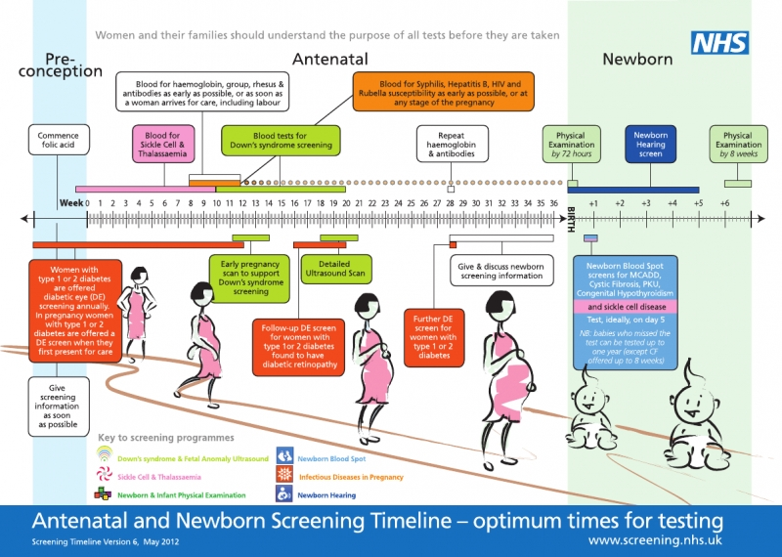

Slide 46
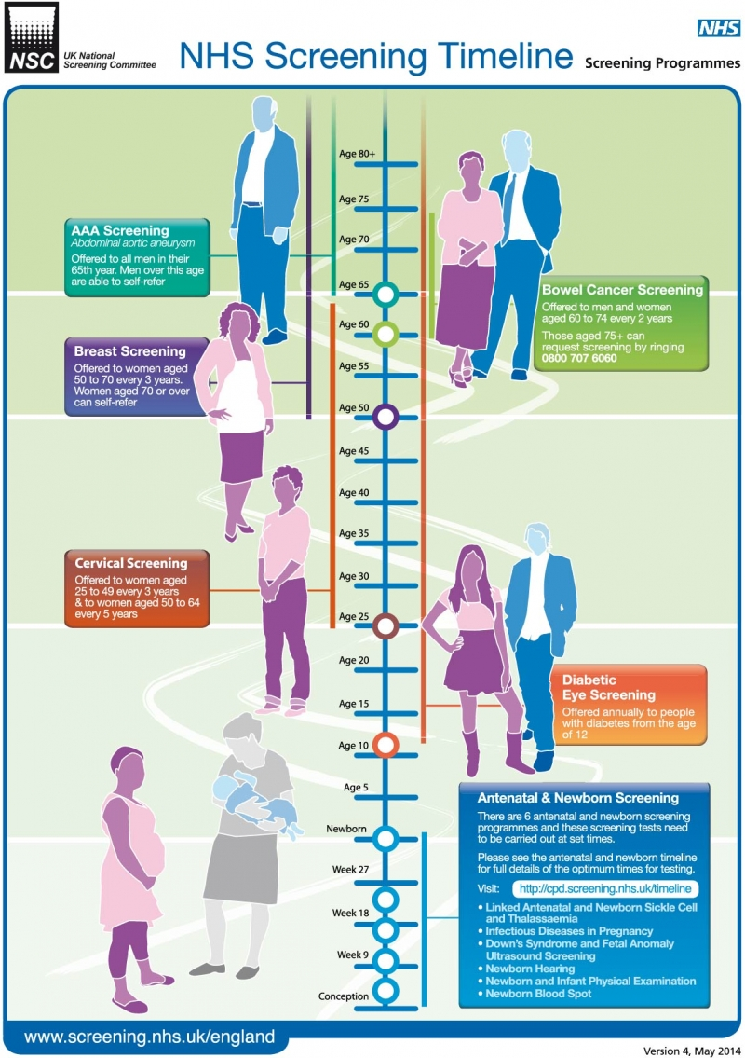

Slide 47
Wilson & Junger Criteria
Important public health problem
Natural history of disease should be understood
Treatment at an early stage should be more benefit than treatment at a later stage
Should be a suitable test – sens, spec, safe, easy to interpret
Test should be acceptable to the population
Should be adequate facilities for diagnosis and treatment.
Intervals of testing identified and understood
There should be a recognizable early stage
The chance of psychological harm to those screened should be less than the chance of benefit.
Cost balanced against the benefit provided

Slide 48
CONDITION:
Common,Important,Diagnosable,Have a latent interval
TEST
Cheap and simple, Continuous – intervals of testing identified and understood,Targeted towards a high risk group.
AND
Disease should be readily treatable,Tests should be sensitive, specific, safe , acceptable and easy to interpret,Benefits outweigh costs

Slide 49
Sensitivity – TRUE POSITIVES: TESTS ABILITY TO CORRECTLY IDENTIFY THOSE WITH DISEASE
IF POSITIVE, YOU PROBABLY DO HAVE CONDITION
Specificity –TRUE NEGATIVES - TESTS ABILITY TO CORRECTLY EXCLUDE THOSE WITHOUT DISEASE
IF TEST IS NEGATIVE, YOU PROBABLY DON’T HAVE CANCER
Incidence – No. of new cases in a given population over a given period of time.
Prevalence – The proportion of people with a finding or disease in a given population at a given time

Slide 50
Sensitivity
The test’s ability to correctly identify those people with disease
So = True Positives
True Positives + False negatives
i.e. all those who truly have the disease

Slide 51
Specificity
The test’s ability to correctly exclude those people without disease
So = True Negatives
True Negatives + False Positives
i.e. all those who truly don’t have the disease

Slide 52
Positive Predictive Value
If the test is positive, what chance is there that the person does have the disease really
= True Positives
True positives + False Positives

Slide 53
Negative Predictive value
If the test is negative, what chance is there that the person doesn’t have the disease.
= True negative
True negative + False negative

Slide 54
Accuracy
What proportion of tests have the correct result
= True positive + True negative
True negative+true positive+false negative+false positive

Slide 55
 | DISEASE PRESENT | DISEASE ABSENT
TEST POSITIVE | a TRUE POSITIVE | b FALSE POSITIVE | a+b TOTAL WITH POSITIVE TEST
TEST NEGATIVE | c FALSE NEGATIVE | d TRUE NEGATIVE | c+d TOTAL WITH NEGATIVE TEST
 | a+c TOTAL WITH DISEASE AS PER GOLD STANDARD | b+d TOTAL DISEASE FREE | a+b+c+d TOTAL ALL

Slide 56
Urinalysis to prove diabetes
 | DIABETIC | NOT DIABETIC | TOTAL
GLYCOSURIA | 6 a | 7 b | 13 a+b
NO GLYCOSURIA | 21 c | 966 d | 987 c+d
TOTAL | 27 a+c | 973 b+d | 1000
Notes:
Can you calc sens , spec, ppv and npv

Slide 57
Sensitivity = a/a+c = 6/27=22.2%
Specificity = d/b+d =
966/973 =99.3%
positive predicitive value = 6/13 = 46.2%
negative predicitve value = d/c+d = 966/987=97.9%.
Accuracy : a+d/ a+b+c+d= 6+966/1000=97.2%
 | DM+ | DM-
Urine+ | 6 | 7 | 13
Urine - | 21 | 966 | 987
 | 27 | 973 | 1000

Slide 58
USING ECG IN PTS WITH CHEST PAIN TO PREDICT CORONARY ARTERY STENOSIS
 | CAS ON ANGIO | NORMAL VESSELS ON ANGIO | TOTAL
ECG CHANGES | 137 | 11
NO ECG CHANGES | 90 | 112
TOTAL
Complete table
Sensitivity
Specificity
PPV
NPV

Slide 59
DISEASE
PRESENT ABSENT
TEST POSITIVE 137 11
NEGATIVE 90 112
Sensitivity = a/a+c = 137/137+90 = 60%
Specificity = d/b+d = 112/11+112= 91%;
positive predicitive value = 137/137+11= 93%;
negative predicitve value = 112/90+112 = 55%.

Slide 60
Chlamydia
With leukocyte esterase dipstix (LED) for chlamydia vs ‘gold standard’
In a GUM clinic 500 patients were tested, 100 tested positive with gold standard, 90 tested positive with LED. Of these 90, 5 were in fact negative with the gold standard.
What is the sensitivity and specificity of LED?
What is PPV?
Notes:
Sensitivity = 85/100 = 85%,Specificity = 395/400 = 98%, PPV = a/a+c = 85/90 = 94%.

Slide 61
 | Gold standard positive | Gold standard negative | Total tested
Test positive | 85 | 5 | 90
Test negative | 15 | 395 | 410
Total | chlam 100 | Without chlam 400 | 500

Slide 62
Guthrie test
The Guthrie test for congenital hypothyroidism is 99% sensitive but has a positive predictive value of 6%.
What does this mean? Explain in plain english.

Slide 63
The test is able to identify 99 % of babies with the disease so a negative test is extremely reassuring
But,
If the test is positive, the chances of you child being affected are 6% - ie if 100 babies were Guthrie positive, only 6 would actually have the disease

